Slide 1
TV channel in the cloud
Powered by Gstreamer
Jurijs Šatcs <jurijs.satcs@veset.tv>
Notes:
Hi my name is Jurijs Satcs from company called Veset. Thank you etc
We are developing a streaming application for TV channels and I am going to share our experience

Slide 2
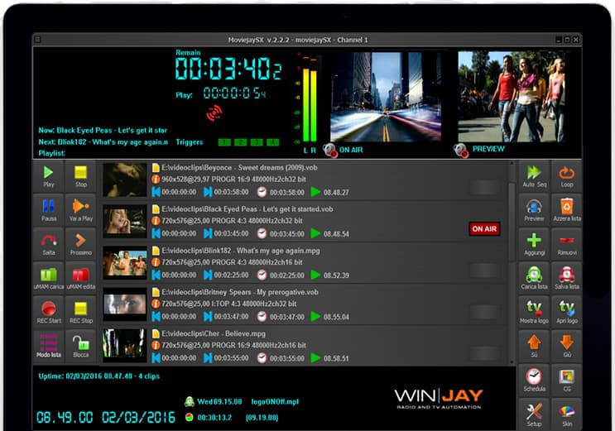
Traditional TV channel
Video switcher
Audio processor
Video router
Convertor
Encoder
Playout software
Notes:
Before we discuss gstreamer stuff, some background. Now, what is a TV channel. It has a bunch of equipment like this. These boxes are very powerful – each one can encode, decode and mix, in short every box does what a gstreamer plugin can do, so this was ready for disruption.

Slide 3
Veset background
Founded in 2011 in Latvia
Product is called Nimbus
Notes:
So, Veset was founded. We Latvians always have to explain to everyone where Latvia is so here’s mandatory picture.
Initially it was just a few guys with one client, and they rolled out a backend and UI, and the first playout, not based on gstreamer at that time. And they called the product Nimbus because it’s Latin for cloud.

Slide 4
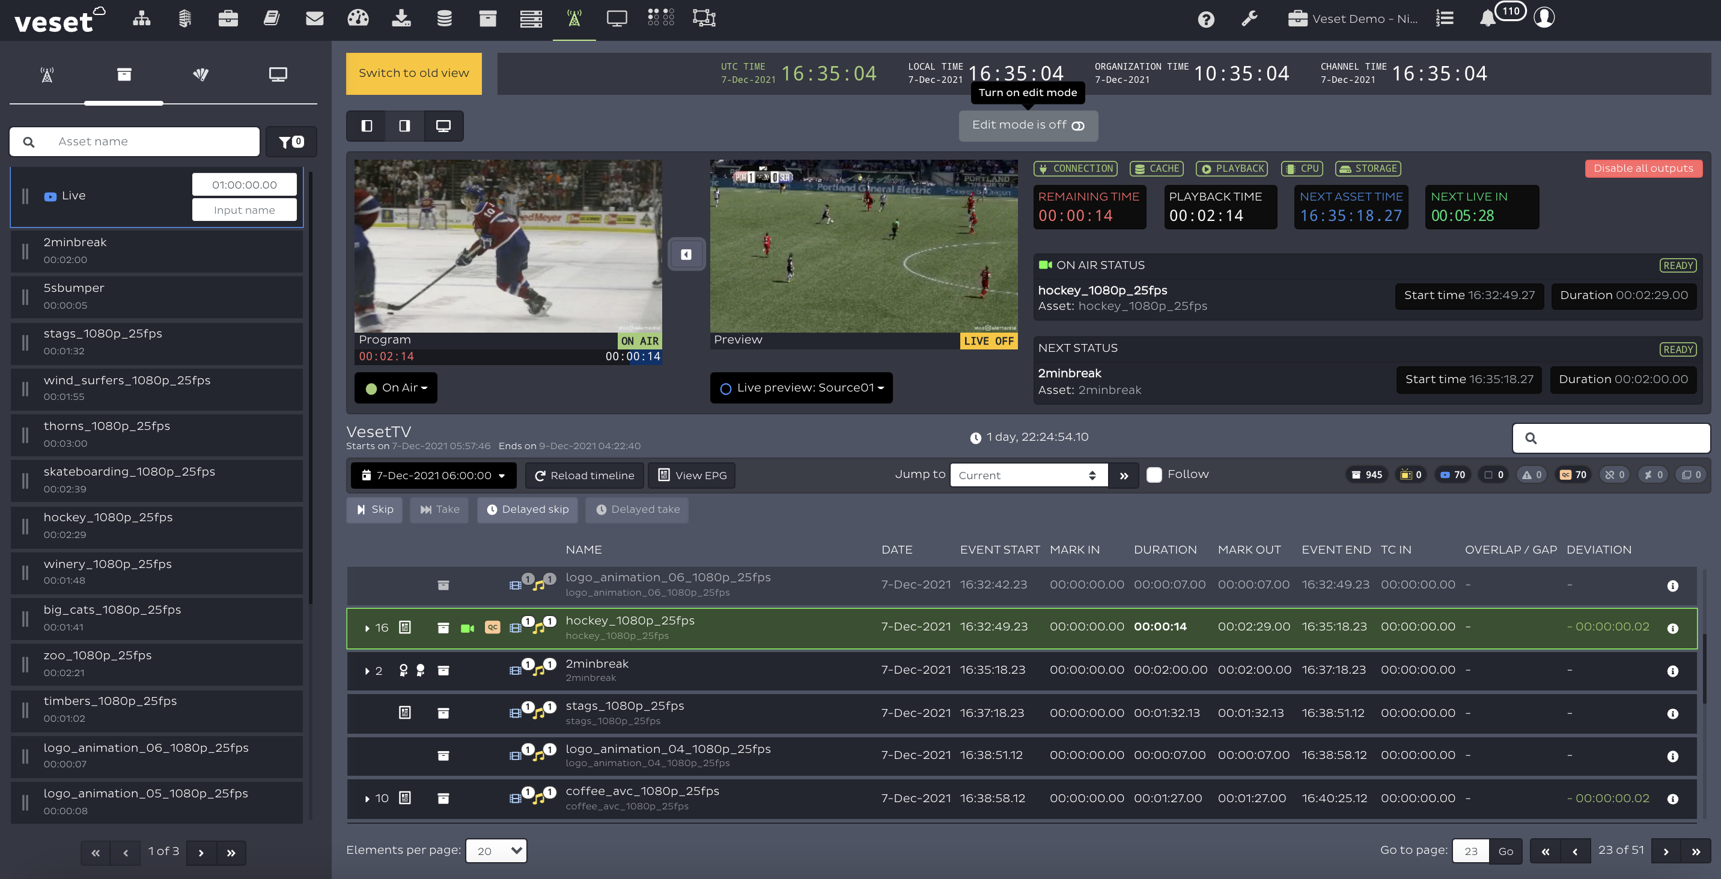
Veset background
Gstreamer playout in production since 2017
Company owned by Play TV (Japan) since 2023
150 channels
Nimbus
Notes:
We also used to have products called Cirrus and Stratus which are types of cloud, but these did not fly. Only Nimbus is left.
At some point we re-wrote playout based on Gstreamer.
Eventually our biggest client bought the company because we became critical for their business.
We are about 15 people now, of which 3 are full-time developing playout module, all of us are here
We did not change the world yet, 150 channels is not much. Still plenty of metal boxes to replace

Slide 5
Channel UI
Output and live previews
Switch to live feed
Export AsRun logs in real time
5
playlist
Modify playlist on the fly
Take an upcoming event
Notes:
Here’s one of the application screens where user controls the playout. You see the upcoming playlist in the bottom part, and there’s various controls for manual override

Slide 6
Deployment architecture
AWS Veset account
AWS Client account
Channel
Ingest
Playouts
Playouts
Playouts
Library
Monitoring
Playout management
Storage
Web UI
Notes:
Application is deployed in the cloud. Our microservices are in our AWS account, and each client has playouts and storage buckets in their own account.
Each playout is on its own VM, client can choose one of AWS sizes, from 4 to 64 cores. It is all CPU-based, for most clients that’s the point as these instances are much cheaper.

Slide 7
Requirements
Play 24/7
Files and live streams
Switch between shows (“events”) according to schedule
Overlay graphics
Multiple outputs
Notes:
The basic requirements are the following. We have to play 24/7, meaning no crash or leak. We play different types of content, each show we play can have different original resolution, framerate, audio quality, etc. On output it should all have the same parameters.
We are supposed to switch between events precisely, 9 o’clock news should start exactly at 9, and 30-second commercial must be exactly 899 frames. Also, user can change the playlist, even at the last moment.
We need some graphic overlays, I’ll come to that, the simplest example is a channel logo in the corner.
And we stream it all to multiple outputs, each has its own resolution, bitrate etc

Slide 8
Pipeline: Big picture
Notes:
Every presentation of a gstreamer application must have a slide like this

Slide 9
Notes:
Better view is here

Slide 11
Pipeline: Big picture
Video
Current
Event
Sched
Proc
Graphics
Proc
Enc
Proc
Enc
Mux
Sink
Next
Event
N * Audio
Sched
Proc
Effects
Proc
Enc
Proc
Mux
Sink
Black screen
Sched
Enc
N * Subtitles
Notes:
And this is a very simplified picture.
At the heart are schedulers. We have as many schedulers as we have elementary streams. One for video, one for every audio track and one for every subtitle track
Source bins on the left. We create are destroy them as we go. Each source bin has as many source pads as elementary streams. If some source does not have for example audio or subtitles it sends a stream with gaps or silence.
The black one is a special case – this is what we play when we have nothing to play. File not found, live stream ended, or user forgot to send a playlist.
Source can be file-based or live, For live streams we support RTP, RTP FEC. with Error control, RTMP, SRT, HLS, JPEG-XS.
Then we pre-process these streams. In case of video, this is where we convert them all to the same resolution and framerate.
Then we overlay graphics and audio effects such as voiceovers and fadeouts.
Then we are ready to encode. Except that we might need another conversion to a new resolution and framerate and format because all our multiple outputs have different requirements
Finally it all comes together in muxer
Since there’s a lot of element the rest of the pres is going to be chaotic – just some things that we spent a lot of time on

Slide 12
Play 24/7 – naïve implementation
src1
forward
src2
concat
block
block
src3
Notes:
The first challenge was – how do we play 24/7? It seems that there’s a standard element for that, called concat. It forwards buffers from an active pad, and when it receives EOS, it switches to the next one: like this

Slide 13
Play 24/7 – naïve implementation
src1
EOS
src2
concat
forward
block
src3
Notes:
Now concat forwards the stream from the second source and we can disconnect the first one. It seems that if we create one concat for each elementary stream, it should satisfy our requirements

Slide 14
Why concat did not work for us
Only ends on EOS, hard to control
Sudden EOS can cause un-sync between video and audio
Video
movie
news
football
Audio
movie
news
football
Notes:
It did not work for us.
The simplest example where it goes wrong is when one stream is a bit shorter from another. The shorter one switches earlier and now we have audio out of sync. I am sure there was a clever way to make it work but instead we rolled our own.

Slide 15
Nscheduler – concat on steroids
black
pts=0
nscheduler
Notes:
Our concat replacement is called nscheduler, where N stands for Nimbus. On the source pad it sends buffers with ever increasing timestamp, all in one endless segment.
It has multiple sinks, and we start by connecting a special input called “black” to one of the sinks. It’s basically videotestsrc or audiotestsrc, we play it when we have nothing to play.

Slide 16
Nscheduler – concat on steroids
black
nscheduler
sink
pts=3s
Sync=true
baseTime = Now – pts;
Notes:
Then, when it has been running for a few seconds, we can initialize our conversion between clock time and PTS. We always have at least one synchronized sink element, so we take current clock time and subtract current PTS on that sink. From now on we can convert clock times to PTS.

Slide 17
Nscheduler – frame-accurate switching
black
pts=100.0
PTS Range =
100..400s
news
nscheduler
pts=0
pts=99.96
PTS Range =
400..460s
ad
pts=0
Notes:
And then we can create and link more sink pads. Each one has additional properties, the main two are start and end PTS.
Now, in this example, let’s say we have to play a commercial for 5 minutes starting at PTS of 100s. And then we have a one minute commercial break.
So after we’ve forwarded these 100s from the black strean, we know the news must start playing. So we block the first sinkpad and start forwarding the second.

Slide 18
Nscheduler – frame-accurate switching
black
pts=100.0
PTS Range =
100..400s
news
nscheduler
pts=0.08
pts=100.04
PTS Range =
400..460s
ad
pts=0
Notes:
When we switch to some stream we have to do two things.
First, its start PTS also becomes our PTS offset. We increments each incoming buffer’s PTS by that value, so that on the src pad timestamps are increasing.
And other thing is –we has to forward its caps, otherwise downstream doesn’t know how to handle these buffers

Slide 19
Nscheduler – handle unexpected EOS
black
pts=100.0
PTS Range =
100..400s
news
nscheduler
EOS
pts=399
PTS Range =
400..460s
ad
pts=0
Notes:
Now what if a stream is too short? Here we see that news was supposed to play for 300s but only played for 299, and we got an End of stream. We are supposed to switch to the commercial in half a second. We can’t do it too early or audio goes out of sync with video.
We do this:

Slide 20
Nscheduler – fill gaps with black
black
pts=101
nscheduler
pts=399.96
PTS Range =
400..460s
ad
pts=0
Notes:
We temporarily switch to our black, forward this missing second worth of data from there, and disconnect the sink pad we do not need anymore
Of course if this gap is significant, after we switch to black, application is going to handle it and link another input playing some emergency content.

Slide 21
Nscheduler – frame-accurate switching
black
pts=10.44
nscheduler
pts=400.0
PTS Range =
400..460s
ad
pts=0.04
Notes:
And finally we reached start PTS for the ad and we can show it

Slide 22
Graphics
Notes:
Next interesting topic is graphics. Here’s graphic UI. There’s a list of objects on the left, user can drag and drop and set their properties. Then they are added to playlist.

Slide 23
Graphic features
Text
Static image
Video
HTML5
Substitute variables (text/image depending on current content)
L-shaped graphics
Animations
Notes:
Graphics can be text or static images or videos, or HTML5.
HTML5 objects are important because this is what professional design tools output. Designer prepares some complex graphics with transitions and we need to render these in the browser and overlay on top of the main video.
L-shaped graphics is also a big deal for some channels. You’ve seen it – this is when the main picture gets reduced and you see various bells and whistles around.
We implement some simple animations, such as fade-in and fade-out, if user needs something more advanced they use HTML5

Slide 24
Graphics – prepare stream
From scheduler
videoconvert
videoscale
videorare
1920x1080, ARGB, 29.97
compositor
Notes:
This our graphic before overlaying any graphics.
We have to convert our main stream to one of the color schemes that supports transparency and that compositor supports, in this case ARGB. And we scale it to the dimensions of our largest output. So if one is 4K and one is HD, graphics works at 4K, and downstream we split it and downscale one of the streams.
Likewise if outputs have different framerates, we videorate to the highest.

Slide 25
Graphics – static image
From scheduler
videoconvert
videoscale
videorare
1920x1080, ARGB, 29.97
compositor
filesrc
decodebin
videoscale
videobox
imagefreeze
gst_pad_set_offset(startPts)
Notes:
And this is a static image overlay.
Read it from the file, scale to appropriate size. If it has a wrong aspect ratio we use plugin called videobox to add margins. And then use plugin imagefreeze to convert one image to a stream of frames. All standard plugins.
We link this to compositor, and set properties on this sink pad , x, y and z-order and so on. To make it play starting at a certain point we set pad offset to the appropriate value, so that the first buffer generated by image already has correct PTS.

Slide 26
Graphics – movie
From scheduler
videoconvert
videoscale
videorare
1920x1080, ARGB, 29.97
compositor
compositor
Out-of-process
filesrc
decodebin
videoconvert
videorate
videoscale
gst_pad_set_offset(startPts)
Notes:
Overlaying a movie is pretty similar, except that we put source and decodebin into a separate process connected with shared memory, I’ll talk about it later.

Slide 27
Graphics – HTML5
From scheduler
videoconvert
videoscale
videorare
1920x1080, ARGB, 29.97
compositor
Out-of-process
cefsrc
decodebin
videoprocessor
capsfilter
videobox
gst_pad_set_offset(startPts)
Notes:
Overlaying an HTML5 is similar to a movie, except that you need chrome engine. There’s a standard plugin called cefsrc for that. And of course you need way better error handling in this case

Slide 28
Optimizing CPU usage
Processor
Encoder
muxer
RTP 1920x1080. 10 mbps
Processor
Encoder
muxer
SRT
1920x1080. 10 mbps
Video tee
Processor
Encoder
muxer
HLS 1920x1080. 5mbps
Processor
Encoder
muxer
HLS 720x576. 2mbps
Notes:
Completely new subject is a little trick we have for reducing CPU usage.
Let’s say we have these outputs. If we build a pipeline in a straight way we need four encoders, each consuming a few CPU cores.
What we do at the start of the application is we analyze output configuration, and if two encoders are the same, we join them, like this.

Slide 29
Optimizing CPU usage: step 1
muxer
RTP 1920x1080. 10 mbps
Processor
Encoder
T
muxer
SRT
1920x1080. 10 mbps
Video tee
Processor
Encoder
muxer
HLS 1920x1080. 5mbps
Processor
Encoder
muxer
HLS 720x576. 2mbps
Notes:
Sometimes encoders are different but resolution and framerate and video format are the same. So we can save some more CPU and some more unneeded elements, like videoscale or videoformat

Slide 30
Optimizing CPU usage: step 2
muxer
RTP 1920x1080. 10 mbps
Encoder
T
muxer
SRT
1920x1080. 10 mbps
Video tee
Processor
T
Encoder
muxer
HLS 1920x1080. 5mbps
Processor
Encoder
muxer
HLS 720x576. 2mbps

Slide 31
SCTE signaling
SCTE-35 standard
Originally for Ad insertion. Signal shows where to start/end an Ad
Signals embedded in MPEG TS on a separate PID
Each signal has ID and PTS, pointing a few seconds forward
Video
PID=501
Audio
PID=701
SCTE
PID=543
Video
PID=501
Audio
PID=701
Video
PID=501
Audio
PID=701
Video
PID=501
Audio
PID=701
Notes:
Something most people have never heard of is SCTE-35.
MPEG Transport stream may contain an elementary stream, every now and then there’s a block of data in there. This block contains a timestamp. An ID a few more fields. This timestamp points ahead a few seconds. This is ad insertion point. This is how your local TV operator knows where to insert a commercial into a feed it gets from a national TV.

Slide 32
Tools for SCTE
Rtpbin
MpegTsDemux
SCTE signal
GstEvent
GST_CUSTOM_DOWNSTREAM
Probe GstEvent
Application logic
Insert GstEvent
Encoder
MpegTsMux
sink
SCTE signal
Notes:
On gstreamer level it is actually pretty easy. In a live stream mpeg demuxer reads these signals and converts them to regular gstreamer events, and pushes these events via regular video stream. We add a probe and can handle them. And if we want to forward these or inject our own SCTE commands we send a GstEvent to the muxer on the other end.

Slide 33
Uses of SCTE
Generate an SCTE message according to timeline
Read it from live stream and perform some logic.
Read it from live stream and forward
Notes:
People don’t always use it for ad insertion, there are other creative uses for SCTE, especially in Japan. Basically it is the way to embed some commands into the transport stream. Based on event we receive we can switch to live or start the next show, or disable an output.

Slide 34
Subtitles – many different kinds
text/x-raw
?
Video/x-raw
x264enc
muxer
Notes:
Subtitles seem easy, but they are not.
The first major refactoring happened when we first added subtitles and nothing worked. The reason is that subtitle buffer that you read from a file has a huge duration – a few seconds. Very different from video and audio. It did not go well with what we had built at that moment.
Also, it turns out there’s many different types and every client likes their own. We support five types already,

Slide 35
Subtitles – burn-in
text/x-raw
Video/x-raw
textoverlay
x264enc
muxer
Text overlayed on video
Notes:
Simplest type is burn-in subtitles when you simply draw your text on video. Problem – once they are there, the viewer can’t remove. Also, you can’t use more than 1 language, maybe two
There’s a standard plugin for that, called textoverlay. It has very few styling options, we have our own version with better formatting.

Slide 36
Subtitles – DVB
video/x-raw
subpicture/x-dvb
text/x-raw
textrender
dvbsubenc
Video/x-raw
x264enc
muxer
Bitmaps in a separate elementary stream
Notes:
The most common and to me the most normal way is DVB subtitles. That’s elementary stream in MPEG transport stream encoded as bitmaps. For that too there are standard plugins. Textrender paints text on empty canvas and dvbsubenc converts it to the right shape of bitmap. Again we had to add more layout options to these.

Slide 37
Subtitles – VTT
vttSubtitleEncoder
Subtitles in a .VTT file
text/x-raw
Video/x-raw
x264enc
muxer
hlssink
HLSAdaptiveManifest
Manifest refers to HLS fragments and to subtitles
Notes:
If your output is HLS, there are VTT subtitles. This is simply a text file that lives on the server next to your HLS playlist. To use it you need an adaptive manifest.
That’s a list of HLS files, usually more than one with different resolutions, and you can add a subtitle file there as well. There’s no plugin for this, we implemented it at application level.

Slide 38
Subtitles – Closed captions (CEA-608)
(2 characters per buffer!)
text/x-raw
subs2cc
closedcaption/x-cea-708
Video/x-raw
cccombiner
x264enc
muxer
Text in
H.264 SEI
Text in
GstVideoCaptionMeta
(2 characters per frame!)
Notes:
A little painful kind of subtitles is closed captions, CEA 608 standard. You have to split your text into chunks of 2 characters per buffer, and add some control commands like clear screen. Gstreamer has a plugin for that, written in rust. But for some reason we could not make it work in our pipeline, and made our own called subs2cc. You plug this stream of commands into element called cccombiner which converts these into video metadata, also 2 characters per buffer. And then encoder converts this metadata once again, into the H264 enhanced information. So you need about 30 frames, to transmit two short lines of subtitles, that’s one second. So, you receive a subtitle with some timestamp, subtract one second and then start sending it two characters at a time.
The reason for this weirdness is hisrorical. In the analog TV signal closed captions where transmitted during a very short time when the cathod ray goes back between the frames. For compatibility closed captions are still encoded two characters per video frame.

Slide 39
Subtitles – ARIB B24
Live
stream
demuxer
application/x-arib-subtitles
Video/x-raw
x264enc
muxer
Subtitles unchanged
from live input
Notes:
ARIB 24 is Japanese standard for subtitles. There is no decoder or encoder for this, so when we receive them in a live stream we simply pass it from demultipliexor directly to multiplexor.

Slide 40
C++ integration - wrappers
Replace ref-counting with C++ destructors and copy constructors
{ // wrap «transfer floating» reference ElementWrapper enc = gst_bin_get_by_name (bin, «enc»); doSomething(enc); this.enc = enc; } unref here
Notes:
Our app is written in C++, it is rather large, with a mix of typical object-oriented code and calls to gstreamer functions, so we wanted to find some standard way to make it easier and reduce errors. We have wrappers for most common gstreamer types, the primary goal was to hide reference and dereference calls.
When we call a function marked with “transfer floating” or “transfer full” we simply assign it to the wrapper, and then we can use that wrapper in the same way as we would use a raw pointer. When a wrapper goes out of scope it’s going to call unref

Slide 41
C++ integration – wrapper implementation
template <class ObjectType> class GstWrapper { // construct with transfer floating or full GstWrapper(ObjectType *obj) : obj(obj) {} // construct with transfer none, add ref GstWrapper(ObjectType *obj, bool addRef) : obj(obj) { if (addRef) inc_ref(); }
// copy from another wrapper, add ref GstWrapper(const GstWrapper<ObjectType> &other) : obj(other.obj) { inc_ref(); }
Notes:
And if we receive it from function with transfer none, or copy from another wrapper, then we call another constructor which increases reference count.

Slide 42
C++ integration – functional probes
srcPad.addBufferProbe( [this ] (GstBuffer * buf) { this->pts = buf->pts; return GST_PAD_PROBE_PASS; }); srcPad.addEventProbe(GST_EVENT_CAPS, [ this ] (GstEvent * e) { gst_event_parse_caps(e, &this->caps); gst_caps_ref(this->caps); return GST_PAD_PROBE_PASS; });
Notes:
We also wrote some wrappers for probes, so we can use member functions and lambdas.

Slide 43
C+ integration: message bus
gst_bus_add_watch
guint
gst_bus_add_watch (GstBus * bus,
GstBusFunc func,
gpointer user_data)
There can only be a single bus watch per bus, you must remove it before you can set a new one.
Notes:
A problem that we had, may be a common one. This is from documentation to GstBus object. You can add a watch to receive notifications, for example about bus errors. But only one. If your program is large and you want to have some structure to it, this is very limiting. We want to add many watches so that for example every component watches for errors in their part of pipeline.

Slide 44
C+ integration: message bus
struct MessageFilter { GstMessageType messageType, GstObject * src, const std::string & messageStrucName } class GstMessageDispatcher { GstMessageDispatcher(GstBus * bus); int addHandler(MessageFilter filter, HandlerFunc handlerFunc); void removeHandler(int id); }
Notes:
So, we made a dispatcher, where we can add a message handler for a specific message, a specific element or bin in the pipeline, or even for a structure with a specific name. For example handle errors in a specific bin.

Slide 45
Tips and tricks
Crash on criticals
G_DEBUG=fatal-criticals
Crashes on every g_critical
gst_object_unref when refcount=0
gst_object_unref on NULL
Disposing of element where state is not GST_STATE_NULL
…
Notes:
Some random tips that I want to share.
Environment variable G_DEBUG. Part of GLIB. If you set it to fatal-criticals, every call to g_critical function ends with a crash. We started to do it in dev and QA environments. Now it crashes if we make a reference counting error, or forget to set element state to NULL.

Slide 46
Tips and tricks
Controlling latency
video
(min latency = 1.5)
Queue empty
Latency = 1.5s
PTS=1s
Q
Scheduler
processing
x264enc
No data
src
PTS=1s
muxer
PTS=1s
Q
Scheduler
processing
encode
PTS=0
Queue full
(max_size_time=1s)
audio
(max latency = 1.0)
Notes:
Next subject is latency. It took me a while to understand all the problems we had because of this. Sometimes our pipeline would get stuck. There’s no errors but nothing is moving.
Here’s a simple one. We have an x264 encoder, its latency with the usual settings is 1.5 sec. Meaning, it consumes 1.5s worth of video data before it produces the first buffer.
Which means this pipeline is never going to start. Src produces 1s worth of buffers both on audio and video. Audio queue gets full after 1s of data, and the first audio buffer is blocked in the muxer, waiting for the first video buffer. Which never arrives because video encoder only has got 1s of data. It’s not getting any more because source is not producing any more, because it is blocked by audio stream.
I call it latency deadlock.
Sure, in simple cases like this you get a warning from gstreamer saying that minimum latency is larger than maximum. Here minimum latency of video branch is 1.5 and maximum latency of audio branch is 1s.

Slide 47
Tips and tricks
Drop allocation queries
video
Latency =1.5
src1
sched
Q
processing
encode
muxer
src2
sched
Q
processing
encode
audio
Notes:
Another important trick is to drop allocation queries unless you really need them.
Let’s say we added all the queues we needed but when we link a new source and switch to it, there is still a glitch. Maybe sink does not send data for some 200ms, but it is still noticeable.
It turns out (If I understand the problem correctly) when an element starts allocating buffers it send forward an allocation query. And this query waits in the queue with all the buffers. Source is not going to produce any buffers until this queue and all queues downstream, are emptied. Only after queues are empty, encoder’s internal buffer is empty, and sinks sent all the data, then source finally gets the response that no, in fact no one is allocating buffers for you, do it yourself. Then it starts producing buffers, but by that time there’s a gap in the output stream.

Slide 48
Tips and tricks
Drop allocation queries
video
Latency =1.5
src1
sched
ID
Q
processing
encode
Drop-allocation=TRUE
muxer
src2
sched
ID
Q
processing
encode
Drop-allocation=TRUE
audio
Notes:
Solution is to add identity element with parameter drop-allocation=TRUE.

Slide 49
Tips and tricks
Run things out-of process
Dangerous things
File inputs
Live inputs
HTML5 graphics
Outputs that have connection
Helps avoid
Leaks
Crashes due to weird content
Plugin bugs
Notes:
I mentioned how make it crash with G_DEBUG, and now how to make it not crash. Bugs happen, and if they do, we don’t want our playout to crash or run out of memory. So, we moved some things out of process. The good candidates are components that we have to create and destroy repeatedly, such as inputs of any kind, both for main content and graphics.
When an output has a connection, for example RTMP or SRT, that’s another good candidate for being out of process. Before we did that, we saw both leaks and crashes, some of them attributed to our code and some maybe to plugins, but either way we just feel better knowing that all this creation and destruction of elements and connections happens in a child process,

Slide 50
Tips and tricks
Run things out-of process
Input process
Main process
shmsink
shmsrc
nscheduler
video
filesrc
decodebin
shmsink
shmsrc
nscheduler
audio
Does not send
Caps
Audio metadata
Notes:
To connect two pipelines running in two different processes there’s a pair of elements shmsrc and shmsink, shm stands for shared memory. We quickly found we could not use them because they only forward buffers. Receiving end does not know caps or audio metadata that might be needed to process buffers.

Slide 51
Tips and tricks
Run things out-of process
Input process
Main process
Nshmsink
Nshmsrc
nscheduler
video
filesrc
decodebin
Nshmsink
Nshmsrc
nscheduler
audio
Sends
Caps
Audio metadata
Custom events
EOS
Notes:
So we made our own version called nshmsink and nshmsrc, where we added these missing things and a few more for signaling. It has some performance penalty, especially on high resolutions and high framerates when you copy 8 megapixels 60 times a second between regular and shared RAM. Original shmsink can allocate directly in shared memory, we need to use that in our version

Slide 52
Tips and tricks
Flow debugging
Sync=true
Expected PTS = 1234s
Actual PTS = 1232s
What if it runs too slowly?
What if it is stuck completely?
Who’s to blame?
Notes:
As I said we have at least synchronized outputs and we monitor, to make sure pipeline runs smoothly. We expect PTS to increment by 1s every second. But what if it runs too slowly. What if it stops completely. How do we find a guilty element or guilty code?

Slide 53
Tips and tricks
Flow debugging
bin1
bin2
bin3
Notes:
Let’s say we have three elements or three bins one after the other

Slide 54
Tips and tricks
Flow debugging
bin1
Flow debugger
Flow debugger
bin2
bin3
blocked = true;
block_time = now;
gst_pad_push(srcPad, buffer);
blocked = false;
idle_time = now;
Notes:
We insert an element we developed called flow-debugger before each of them. Every time flow debugger pushes a buffer or event or query it instruments that call. At any time we know the state. If it is in gst_pad_push function we call this element blocked, otherwise we call it idle.

Slide 55
Tips and tricks
Flow debugging
bin1
Flow debugger
Flow debugger
bin2
bin3
PTS=124.2
Status=blocked
Load=90%
Last=caps query
PTS=123.2
Status=idle
Load=0%
Last=buffer
Notes:
At any time we know whether element is blocked or idle, for how long, last PTS and last event or query it pushed, and also load – percentage of time it spent in gst_pad_push over the last few seconds.
When bad things happen we print this out, and we know where the problem is, whether it is performance related or some lock.

Slide 56
Tips and tricks
Breaking links in a running pipeline
Unlinking is hard!
Notes:
The most dangerous place for us is unlinking and removing elements. This is where many crashes happen.
One mistake I used to make is unlink an element from its own thread. Let’s say we received EOS and decide to unlink element that sent it. This is wrong because function an event, including EOS, is holding element lock. When we call unlink, we try to obtain that lock once again and our thread hangs.
I think it’s a good rule in general to not do any business logic in streaming threads. For example in probes. Probe should set variables and return. Also it’s a good idea to always know in which thread you are.

Slide 57
Tips and tricks
Breaking links in a running pipeline
Unlinking is hard!
Don’t unlink from streaming thread
Notes:
One mistake I used to make is unlink an element from its own thread. Let’s say we received EOS and decide to unlink element that sent it. This is wrong because function pushing an event, gst_pad_push_event, is holding a pad lock. And this probably happens in a chain of calls where many other pads and elements are locked. When we call unlink, we try to obtain that lock once again and our thread hangs.
I think because of this it’s a good rule in general to not do any business logic in probes. Probe should set variables and return.

Slide 58
Tips and tricks
Breaking links in a running pipeline
Unlinking is hard!
Don’t unlink from streaming thread
Destroy elements before C++ objects
Notes:
Another mistake is the wrong order of destruction, for example to destroy your object, in this case C++ before the corresponding element is fully destroyed. For example, we might still have a probe that refer to our member variable.
Sometimes for a complicated object we have to write a destructor specifically in order to control order of destruction.
Also it is a good idea to remove all the probes before destroying.

Slide 59
Tips and tricks
Idle probes are not what they seem
gst_pad_add_probe(pad, GST_PAD_PROBE_TYPE_IDLE…)
In which thread does the probe run?
Is the pad locked?
Notes:
Before I said it’s a good idea to know in which thread you are. Idle probes don’t allow you to do this. You call add_probe with the flag IDLE. When the pad is not busy, probe is run in the caller thread, and pad is not locked. Otherwise in a streaming thread, when the pad is locked. So, it’s a good idea to not lock anything in idle probe.

Slide 60
Tips and tricks
Idle probes are not what they seem
Does it run only once?
static GstPadProbeReturn
pad_probe_cb (GstPad * pad, GstPadProbeInfo * info, gpointer user_data)
{
called++;
return GST_PAD_PROBE_REMOVE;
}
Notes:
Another problem we saw a few times. We install an idle probe and return PROBE_REMOVE from probe function. And we hope it only gets called once. But every now and then, pretty rarely, it gets called twice. The reason is that when this probe is called in the same thread, it gets called without locking the pad. Meanwhile before we return REMOVE the pad may get the buffer, handle it and call the idle probe.
So if your goal is to execute probe once you need to protect it with some additional variable.

Slide 61
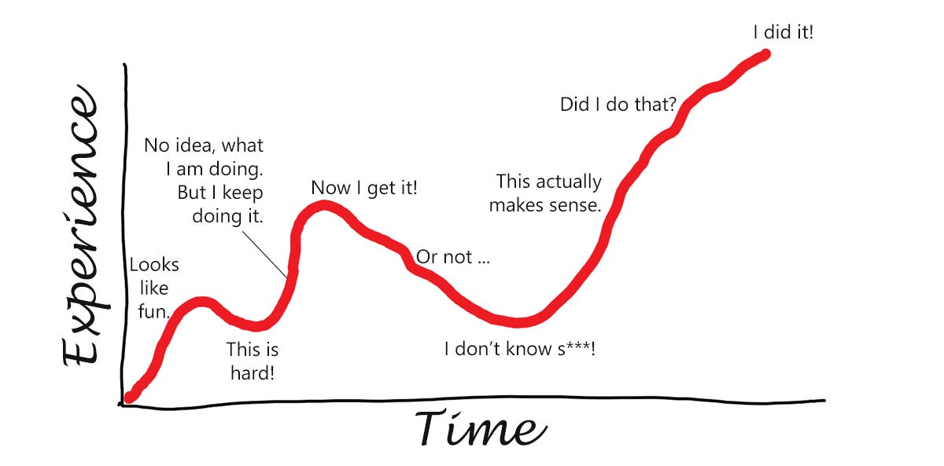
Conclusion: learning curve
You are here
Notes:
In conclusion I’d like to say that I really like working with gstreamer. And thank the team in Centricular for their support. My learning curve looks like it, I am well past “now I get it” point, sometimes still in the valley of “or not”, but more and more often in “this actually makes sense” area. Thank you for the product and thank you for listening

