Slide 1



Every Camera
a Snowflake
Building a VMS that works with thousands of camera models.
GStreamer Conference 2026 James Nickerson
1

Slide 2








CONTEXT
What a VMS asks of a camera
Before doing anything fancy…
Discover
Configure
Stream
Record
Events
PTZ
Talk
WS-Discovery multicast probes
ONVIF over SOAP: profiles, encoders, time, network
RTSP, SDP, RTP, RTCP over UDP or TCP
Matroska archives, split on keyframes
ONVIF metadata XML carried in RTP
Continuous, absolute, presets, home
RTSP backchannel: Audio back to the camera
2

Slide 3

CONTEXT
3

Slide 4

CONTEXT
3

Slide 5
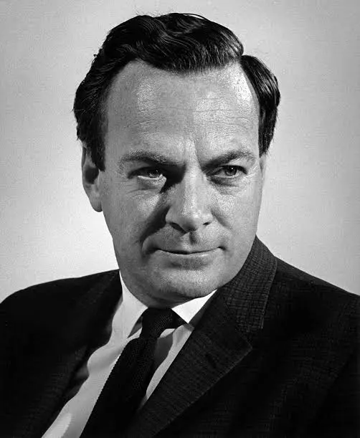
CONTEXT
3

Slide 6
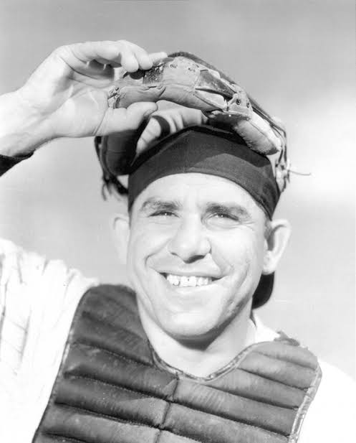
CONTEXT
3

Slide 7
CONTEXT
"In theory, there's no difference between theory and practice.
In practice, there is."
3

Slide 8
THE POPULATION
Camera self-reported identities (by count)
4

Slide 9
THE POPULATION
Camera self-reported identities (by count)
195244 "axis"
159062 "hanwha"
37908 "not specified"
12160 "i3 international"
4884 "clinton"
4058 "onvif"
2257 "viewz2"
1868 "lts"
1706 "digital watchdog"
1099 "onvif_icamera"
1090 "idis americas"
724 "hikvision"
718 "amcrest"
628 "invid-1"
545 "openeye"
429 "vivotek"
352 "fs"
300 "konntek"
258 "aiphone"
255 "uniview"
237 "geovision"
212 "speco"
179 "panasonic"
177 "turing-u"
159 "avigilon"
139 "ipcamera"
123 "liberty"
103 "ipcam"
93 "arecont vision"
89 "sightlogix"
75 "innotech"
68 "idis"
66 "interlogix"
56 "pelco"
54 "general"
51 "bosch"
49 "reolink"
33 "sony"
29 "mobotix"
22 "tyco security products"
20 "i-pro"
14 "oncam grandeye"
13 "dahua"
12 "backstreet"
11 "evolution"
8 "flir"
8 "a_onvif_camera"
7 "digimerge"
7 "advidia"
7 "acti corporation"
6 "homaxi"
4 "manufacturer"
3 "capture advance"
3 "alibi"
2 "optiview"
2 "onvif_ipnc"
2 "lorex"
2 "grandstream"
2 "east"
2 "avycon"
1 "zenitel"
1 "nobrand"
1 "milesight technology co.
1 "epcom"
1 "champ"
1 "canon"
1 "atv"
1 "2n
4

Slide 10
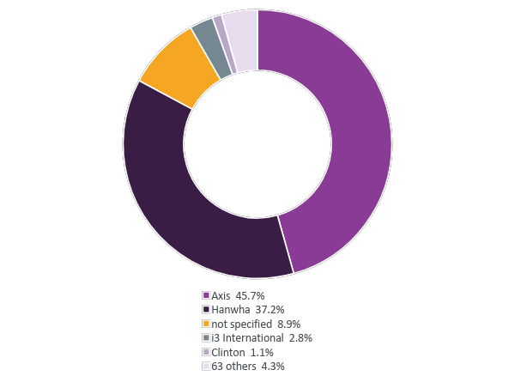
THE POPULATION
Camera self-reported identities
427,702
cameras on cloud-connected systems
68
distinct manufacturer strings
83%
are two vendors: Axis and Hanwha
4

Slide 11
THE POPULATION
Camera self-reported identities (by count)
195244 "axis"
159062 "hanwha"
4

Slide 12
THE POPULATION
Camera self-reported identities (by count)
195244 "axis"
159062 "hanwha"
37908 "not specified"
4

Slide 13
THE POPULATION
Camera self-reported identities (by count)
195244 "axis"
159062 "hanwha"
37908 "not specified"
12160 "i3 international"
4884 "clinton"
4058 "onvif"
2257 "viewz2"
1868 "lts"
1706 "digital watchdog"
1099 "onvif_icamera"
1090 "idis americas"
724 "hikvision"
718 "amcrest"
628 "invid-1"
545 "openeye"
429 "vivotek"
352 "fs"
300 "konntek"
258 "aiphone"
255 "uniview"
237 "geovision"
212 "speco"
179 "panasonic"
177 "turing-u"
159 "avigilon"
139 "ipcamera"
123 "liberty"
103 "ipcam"
93 "arecont vision"
89 "sightlogix"
75 "innotech"
68 "idis"
66 "interlogix"
56 "pelco"
54 "general"
51 "bosch"
49 "reolink"
33 "sony"
29 "mobotix"
22 "tyco security products"
20 "i-pro"
14 "oncam grandeye"
13 "dahua"
12 "backstreet"
11 "evolution"
8 "flir"
8 "a_onvif_camera"
7 "digimerge"
7 "advidia"
7 "acti corporation"
6 "homaxi"
4 "manufacturer"
3 "capture advance"
3 "alibi"
2 "optiview"
2 "onvif_ipnc"
2 "lorex"
2 "grandstream"
2 "east"
2 "avycon"
1 "zenitel"
1 "nobrand"
1 "milesight technology co.
1 "epcom"
1 "champ"
1 "canon"
1 "atv"
1 "2n
4

Slide 14
THE POPULATION
Camera self-reported identities (by count)
37908 "not specified"
1099 "onvif_icamera"
139 "ipcamera"
54 "general"
8 "a_onvif_camera"
4 "manufacturer"
1 "nobrand"
4

Slide 15
THE POPULATION
Camera self-reported identities
427,702
cameras on cloud-connected systems
68
distinct manufacturer strings
83%
are two vendors: Axis and Hanwha
1 in 10
don't say who made them
4

Slide 16

01
Tolerance first
What the core has to absorb before any vendor gets special treatment
5

Slide 17
TOLERANCE
Capture pipeline
decode_queue - video_rate - decoder - decode_tee - bgseg_queue - bg_seg - fakesink
| \
| proxy_video_queue - appsink decoded_proxy_queue - appsink
| /
video_queue - parser - video_tee ------
/ | \
uridecodebin - queue - onvifmetaparse - fakesink | frame_cacher_queue - frame_filter - appsink
\ |
\ filesaver_video_queue - filesplit - video_rate
\ \
audio_queue - parser - audio_tee - filesaver_audio_queue ------------------------- filesaver
\
proxy_audio_queue - appsink
(rtspsrc) <- appsink <- rtppcmupay <- mulawenc <- audiomixer <- appsrc
7

Slide 18
TOLERANCE
Capture pipeline
decode_queue - video_rate - decoder - decode_tee - bgseg_queue - bg_seg - fakesink
| \
| proxy_video_queue - appsink decoded_proxy_queue - appsink
| /
video_queue - parser - video_tee ------
/ | \
uridecodebin - queue - onvifmetaparse - fakesink | frame_cacher_queue - frame_filter - appsink
\ |
\ filesaver_video_queue - filesplit - video_rate
\ \
audio_queue - parser - audio_tee - filesaver_audio_queue ------------------------- filesaver
\
proxy_audio_queue - appsink
(rtspsrc) <- appsink <- rtppcmupay <- mulawenc <- audiomixer <- appsrc
7

Slide 19
TOLERANCE
Ad hoc pipelines
video_queue
parser
tee
We don't know what the camera will send until it sends it.
uridecodebin
queue
onvifmetaparse
audio_queue
parser
tee
7

Slide 20
TOLERANCE
Ad hoc pipelines
video_queue
parser
tee
We don't know what the camera will send until it sends it.
H.264, H.265, AV1, MJPEG, MPEG-4
AAC or G.711
an ONVIF metadata track, or not.
uridecodebin
queue
onvifmetaparse
audio_queue
parser
tee
7

Slide 21
TOLERANCE
Ad hoc pipelines
video_queue
parser
tee
We don't know what the camera will send until it sends it.
H.264, H.265, AV1, MJPEG, MPEG-4
AAC or G.711
an ONVIF metadata track, or not.
uridecodebin autoplugs, and we hijack autoplug-continue to stop at the first compressed caps we recognize, then build the rest of the graph as pads appear.
uridecodebin
queue
onvifmetaparse
audio_queue
parser
tee
7

Slide 22
TOLERANCE
Ad hoc pipelines
video_queue
parser
tee
We don't know what the camera will send until it sends it.
H.264, H.265, AV1, MJPEG, MPEG-4
AAC or G.711
an ONVIF metadata track, or not.
uridecodebin autoplugs, and we hijack autoplug-continue to stop at the first compressed caps we recognize, then build the rest of the graph as pads appear.
uridecodebin
queue
onvifmetaparse
audio_queue
parser
tee
gboolean Orchid_Stream_Pipeline::uridecodebin_autoplug_handler_(
GstElement* bin, GstPad* pad, GstCaps* caps, Orchid_Stream_Pipeline* sp)
{
MediaType type = Media_Helper::get_media_type(caps);
// A quirk may want the RTP depayloader hand-built instead of autoplugged: stop at application/x-rtp.
if (sp->needs_special_rtp_processing_(caps))
return FALSE;
// Unknown, or still RTP: let uridecodebin keep plugging.
if (type == UNKNOWN || type == RTP)
return TRUE;
return FALSE; // H.264, H.265, AV1, JPEG, AAC, G.711, ONVIF metadata: stop here, we take it from this pad.
}
7

Slide 23

TOLERANCE
Trust, but verify
How much variety can there be in a simple boolean?
8

Slide 24
TOLERANCE
Trust, but verify
How much variety can there be in a simple boolean?
std::optional<bool> Onvif_Event_Utils::parse_state_value_if_applicable(std::string value)
{
static const std::map<std::string, bool> permitted_boolean_map = {
{"1", true},
{"0", false},
{"true", true},
{"false", false},
{"on", true},
{"off", false},
{"yes", true},
{"no", false},
{"active", true},
{"inactive", false},
};
boost::to_lower(value);
auto itr = permitted_boolean_map.find(value);
return itr != permitted_boolean_map.end() ? std::make_optional(itr->second) : std::nullopt;
}
8

Slide 25

TOLERANCE
Actually, don't trust at all sometimes
10

Slide 26

TOLERANCE
Actually, don't trust at all sometimes
People assume that time is a strict progression of cause to effect, but actually… it's more like a big ball of wibbly-wobbly, timey-wimey… stuff.
10

Slide 27
TOLERANCE
Actually, don't trust at all sometimes
Camera clocks are often:
wrong
drifting
not NTP-synced at all
repeating timestamps
10

Slide 28
TOLERANCE
Actually, don't trust at all sometimes
So we:
Make buffer timestamps come from the server clock. RTP time only sets the spacing between frames.
Event timestamps are replaced by RTP receive time. They can be in the past for legitimate reasons (Axis, with sway detection on), or for no apparent reason at all.
10

Slide 29
TOLERANCE
Actually, don't trust at all sometimes
So we:
Make buffer timestamps come from the server clock. RTP time only sets the spacing between frames.
Event timestamps are replaced by RTP receive time. They can be in the past for legitimate reasons (Axis, with sway detection on), or for no apparent reason at all.
//! Configure the GStreamer clock to REALTIME so that buffer timestamps relate to the system epoch.
void Orchid_Stream_Pipeline::configure_clock_(boost::intrusive_ptr<GstElement>& pipeline)
{
GstClock* my_clock = gst_pipeline_get_clock(GST_PIPELINE(pipeline.get()));
// Note: If the system clock changes (due to NTP or directly by user) it is possible for the pipelines to stall.
// In our tests the pipelines stall proportionally to the amount of time change (particularly if the clock
// is changed to an earlier time). Since we have the clock_watcher class, the stalling is limited.
g_object_set(my_clock, "clock-type", GST_CLOCK_TYPE_REALTIME, NULL);
gst_object_unref(my_clock);
}
10

Slide 30
TOLERANCE
Even when it's wrong, it's not wrong
void ProfileS::initialize_ptz_(const ptree& ptz_configuration)
{
// Note that while "DefaultAbsolutePantTiltPositionSpace" seems like a typo,
// and probably was at one point,it is evidently what cameras are actually providing.
constexpr std::array default_space_paths = {
"DefaultContinuousPanTiltVelocitySpace",
"DefaultRelativePanTiltTranslationSpace",
"DefaultAbsolutePantTiltPositionSpace",
"DefaultContinuousZoomVelocitySpace",
"DefaultRelativeZoomTranslationSpace",
"DefaultAbsoluteZoomPositionSpace",
"DefaultPTZSpeed.PanTilt.<xmlattr>.space",
"DefaultPTZSpeed.Zoom.<xmlattr>.space",
};
GetSystemDateAndTime refuses?
Don't believe the spec saying it's unauthenticated. Many cameras want the auth header anyway, so we retry with the header ((TODO) which we needed the time to build)
GetCompatibleConfigurations unsupported?
11

Slide 31
TOLERANCE
Even when it's wrong, it's not wrong
"DefaultContinuousPanTiltVelocitySpace",
"DefaultRelativePanTiltTranslationSpace",
"DefaultAbsolutePantTiltPositionSpace",
GetSystemDateAndTime refuses?
Don't believe the spec saying it's unauthenticated. Many cameras want the auth header anyway, so we retry with the header ((TODO) which we needed the time to build)
11

Slide 32
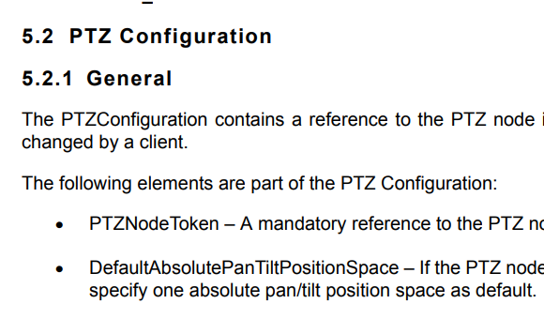
TOLERANCE
Even when it's wrong, it's not wrong
"DefaultContinuousPanTiltVelocitySpace",
"DefaultRelativePanTiltTranslationSpace",
"DefaultAbsolutePantTiltPositionSpace",
GetSystemDateAndTime refuses?
Don't believe the spec saying it's unauthenticated. Many cameras want the auth header anyway, so we retry with the header ((TODO) which we needed the time to build)
11

Slide 33
02
When tolerance isn't enough
The quirks system: per-manufacturer and per-model exceptions
12

Slide 34
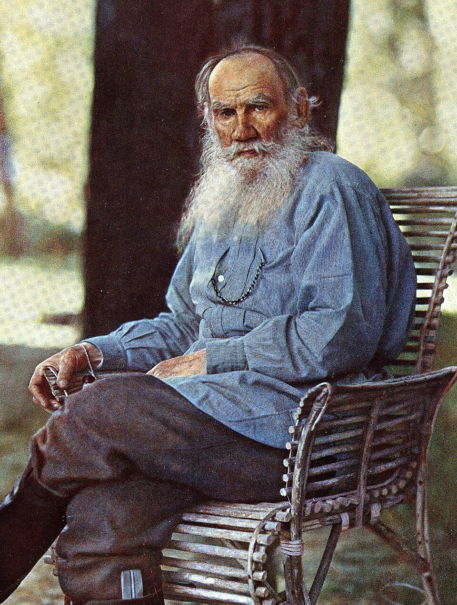
ANA KARENINA
The Nature of Cameras
"All compliant cameras are alike;
each non-compliant camera is non-compliant in its own way."
Leo Tolstoy
15

Slide 35
ANA KARENINA
The Nature of Cameras
Quirks file
15

Slide 36
BOSCH AND BEYOND
"Short headers": the first quirk
short-header
2014
Bosch Dinion HD 400
if (params_.connection_config.get<bool>("Options.short-header", false))
g_object_set(rtspsrc, "short-header", TRUE, NULL);
15

Slide 37
BOSCH AND BEYOND
"Short headers": the first quirk
short-header
2014
Bosch Dinion HD 400
if (params_.connection_config.get<bool>("Options.short-header", false))
g_object_set(rtspsrc, "short-header", TRUE, NULL);
What rtspsrc short-header actually does
"Only send the basic RTSP headers for broken encoders."
Skips the before_send hook of RTSP extension plugins, which is where extensions can decorate every request with additional headers.
15

Slide 38
BOSCH AND BEYOND
"Short headers": the first quirk
short-header
2014
Bosch Dinion HD 400
if (params_.connection_config.get<bool>("Options.short-header", false))
g_object_set(rtspsrc, "short-header", TRUE, NULL);
2015
Panasonic
What rtspsrc short-header actually does
"Only send the basic RTSP headers for broken encoders."
Skips the before_send hook of RTSP extension plugins, which is where extensions can decorate every request with additional headers.
2017
Canon VB-H43
2017
Bosch AutoDome Jr
15

Slide 39

BOSCH AND BEYOND
"Short headers": the first quirk
short-header
2014
Bosch Dinion HD 400
if (params_.connection_config.get<bool>("Options.short-header", false))
g_object_set(rtspsrc, "short-header", TRUE, NULL);
2015
Panasonic
What rtspsrc short-header actually does
"Only send the basic RTSP headers for broken encoders."
Skips the before_send hook of RTSP extension plugins, which is where extensions can decorate every request with additional headers.
2017
Canon VB-H43
2017
Bosch AutoDome Jr
15

Slide 40
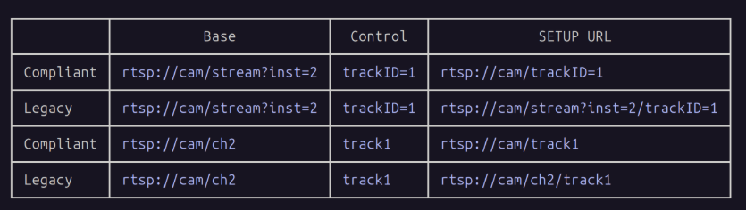
THE RTSPSRC SETUP URL DANCE
When fixing things breaks them
GStreamer 1.18
Fixes rtspsrc non-standards-compliant behavior. Stops appending the control attribute to the end of the SETUP URI.
Some cameras break.
simple-setup-uri
15
24

Slide 41
THE RTSPSRC SETUP URL DANCE
When fixing things breaks them
GStreamer 1.18
GStreamer 1.22
Fixes rtspsrc non-standards-compliant behavior. Stops appending the control attribute to the end of the SETUP URI.
Some cameras break.
rtspsrc now retries with the non-compliant URL, on a 404 or 400.
*Hooray?
simple-setup-uri
simple-setup-uri
15
24

Slide 42
THE RTSPSRC SETUP URL DANCE
When fixing things breaks them
GStreamer 1.18
GStreamer 1.22
Fixes rtspsrc non-standards-compliant behavior. Stops appending the control attribute to the end of the SETUP URI.
Some cameras break.
rtspsrc now retries with the non-compliant URL, on a 404 or 400.
Bosch VIDEOJET Multi 4000 doesn't fail though; it just plays the wrong source.
simple-setup-uri
simple-setup-uri
15
24

Slide 43
THE RTSPSRC SETUP URL DANCE
When fixing things breaks them
GStreamer 1.18
GStreamer 1.22
GStreamer 1.24.7
Fixes rtspsrc non-standards-compliant behavior. Stops appending the control attribute to the end of the SETUP URI.
Some cameras break.
rtspsrc now retries with the non-compliant URL, on a 404 or 400.
Bosch VIDEOJET Multi 4000 doesn't fail though; it just plays the wrong source.
Centricular adds force-non-compliant-url.
Everyone wins.
simple-setup-uri
simple-setup-uri
force-non-compliant-url
15
24

Slide 44
THE RTSPSRC SETUP URL DANCE
When fixing things breaks them
GStreamer 1.18
GStreamer 1.22
GStreamer 1.24.7
Fixes rtspsrc non-standards-compliant behavior. Stops appending the control attribute to the end of the SETUP URI.
Some cameras break.
rtspsrc now retries with the non-compliant URL, on a 404 or 400.
Bosch VIDEOJET Multi 4000 doesn't fail though; it just plays the wrong source.
Centricular adds force-non-compliant-url.
Everyone wins.
simple-setup-uri
simple-setup-uri
force-non-compliant-url
// In rare cases we want the legacy approach from GStreamer 1.16 and earlier, because some RTSP sources are
// themselves not quite standards-compliant in how they use the SDP control field, and work better with it.
//
// For example, the Bosch VIDEOJET multi 4000 encoder can only play one of its channels without this option set
// (and because the pipeline still starts up, the built-in fallback to the old logic doesn't get triggered).
//
// As of GStreamer 1.24.7 there is official support for this via force-non-compliant-url,
// so we no longer need our previous (equivalent) simple-setup-uri patch.
if (params_.connection_config.get<bool>("Options.force-non-compliant-url", false))
g_object_set(rtspsrc, "force-non-compliant-url", TRUE, NULL);
15
24

Slide 45
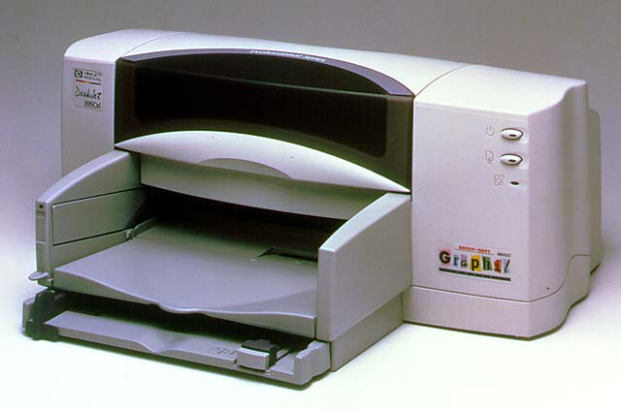
THE RTSPSRC SETUP URL DANCE
When fixing things breaks them
GStreamer 1.18
GStreamer 1.22
GStreamer 1.24.7
Fixes rtspsrc non-standards-compliant behavior. Stops appending the control attribute to the end of the SETUP URI.
Some cameras break.
rtspsrc now retries with the non-compliant URL, on a 404 or 400.
Bosch VIDEOJET Multi 4000 doesn't fail though; it just plays the wrong source.
Centricular adds force-non-compliant-url.
Everyone wins.
simple-setup-uri
simple-setup-uri
force-non-compliant-url
// In rare cases we want the legacy approach from GStreamer 1.16 and earlier, because some RTSP sources are
// themselves not quite standards-compliant in how they use the SDP control field, and work better with it.
//
// For example, the Bosch VIDEOJET multi 4000 encoder can only play one of its channels without this option set
// (and because the pipeline still starts up, the built-in fallback to the old logic doesn't get triggered).
//
// As of GStreamer 1.24.7 there is official support for this via force-non-compliant-url,
// so we no longer need our previous (equivalent) simple-setup-uri patch.
if (params_.connection_config.get<bool>("Options.force-non-compliant-url", false))
g_object_set(rtspsrc, "force-non-compliant-url", TRUE, NULL);
15
24

Slide 46
Our old friend, the Digital Watchdog
Three behaviors, each fine on their own
Digital Watchdog DW-ENHD16
Camera
h264parse
matroskamux
Sends SPS, PPS and the IDR frame with the same RTP timestamp.
Sees duplicate timestamps and marks all but one GST_CLOCK_TIME_NONE. Reasonable.
Drops any buffer without a valid timestamp. Also reasonable.
14

Slide 47
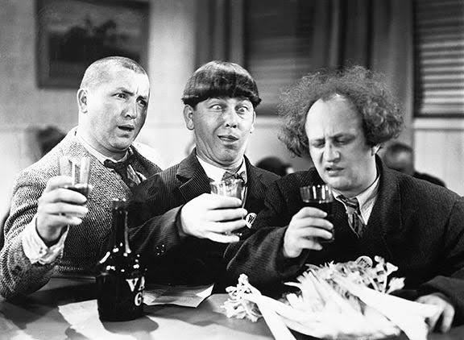
Our old friend, the Digital Watchdog
Three behaviors, each fine on their own
Digital Watchdog DW-ENHD16
Camera
h264parse
matroskamux
Sends SPS, PPS and the IDR frame with the same RTP timestamp.
Sees duplicate timestamps and marks all but one GST_CLOCK_TIME_NONE. Reasonable.
Drops any buffer without a valid timestamp. Also reasonable.
14

Slide 48
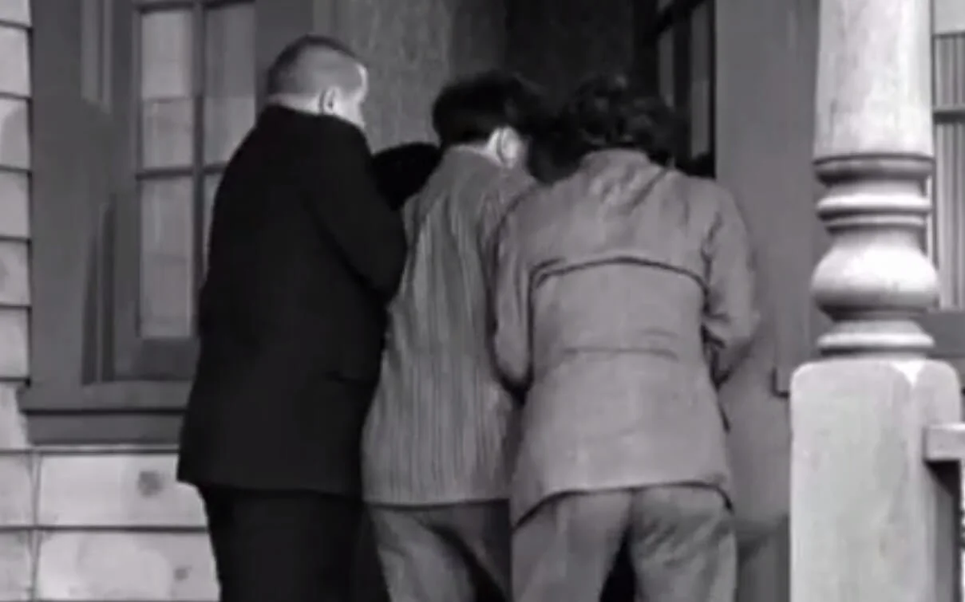
Our old friend, the Digital Watchdog
Three behaviors, each fine on their own
Digital Watchdog DW-ENHD16
Camera
h264parse
matroskamux
Sends SPS, PPS and the IDR frame with the same RTP timestamp.
Sees duplicate timestamps and marks all but one GST_CLOCK_TIME_NONE. Reasonable.
Drops any buffer without a valid timestamp. Also reasonable.
14

Slide 49
Our old friend, the Digital Watchdog
Three behaviors, each fine on their own
Digital Watchdog DW-ENHD16
Camera
h264parse
matroskamux
Archive
Sends SPS, PPS and the IDR frame with the same RTP timestamp.
Sees duplicate timestamps and marks all but one GST_CLOCK_TIME_NONE. Reasonable.
Drops any buffer without a valid timestamp. Also reasonable.
The first frame of every GOP is gone.
14

Slide 50
Our old friend, the Digital Watchdog
Three behaviors, each fine on their own
Digital Watchdog DW-ENHD16
Camera
h264parse
matroskamux
Archive
Sends SPS, PPS and the IDR frame with the same RTP timestamp.
Sees duplicate timestamps and marks all but one GST_CLOCK_TIME_NONE. Reasonable.
Drops any buffer without a valid timestamp. Also reasonable.
The first frame of every GOP is gone.
force-byte-stream-nal-h264-format
Stop autoplugging at RTP and hand-build rtph264depay with byte-stream output so the RTSP proxy works too.
14

Slide 51
Our old friend, the Digital Watchdog
Three behaviors, each fine on their own
Digital Watchdog DW-ENHD16
Camera
h264parse
matroskamux
Archive
Sends SPS, PPS and the IDR frame with the same RTP timestamp.
Sees duplicate timestamps and marks all but one GST_CLOCK_TIME_NONE. Reasonable.
Drops any buffer without a valid timestamp. Also reasonable.
The first frame of every GOP is gone.
force-byte-stream-nal-h264-format
process-duplicate-h264-timestamps
Stop autoplugging at RTP and hand-build rtph264depay with byte-stream output so the RTSP proxy works too.
A pad probe on h264parse's source pad re-stamps invalid buffers with the last valid PTS.
14

Slide 52
A TALE
Offensive Weaponry
2

Slide 53
A TALE
Offensive Weaponry
ONVIF GetVideoEncoderConfigurationOptions call asks the camera what encoder settings it supports.
We passed it a profile token, as the spec allows…
2

Slide 54
A TALE
Offensive Weaponry
ONVIF GetVideoEncoderConfigurationOptions call asks the camera what encoder settings it supports.
We passed it a profile token, as the spec allows…
On VIVOTEK cameras the call sometimes fails, and the camera stays broken until a reboot or a factory reset.
2

Slide 55

A TALE
Offensive Weaponry
ONVIF GetVideoEncoderConfigurationOptions call asks the camera what encoder settings it supports.
We passed it a profile token, as the spec allows…
On VIVOTEK cameras the call sometimes fails, and the camera stays broken until a reboot or a factory reset.
2

Slide 56
A TALE
Offensive Weaponry
ONVIF GetVideoEncoderConfigurationOptions call asks the camera what encoder settings it supports.
We passed it a profile token, as the spec allows…
// The GetVideoEncoderConfigurationOptions call with
// Vivotek cameras will sometimes fail, leaving the
// camera in a broken state until rebooted or factory
// reset. ... Omitting the profile token argument in
// the ONVIF call resolves this issue.
profile_token_arg = omit_profile_token ? "" : token;
On VIVOTEK cameras the call sometimes fails, and the camera stays broken until a reboot or a factory reset.
So yeah, we now omit the token
on VIVOTEK cameras.
get-video-encoder-config-options-without-profile-token
2

Slide 57
03
Fixing it at the source
Patches, patches, patches
18

Slide 58
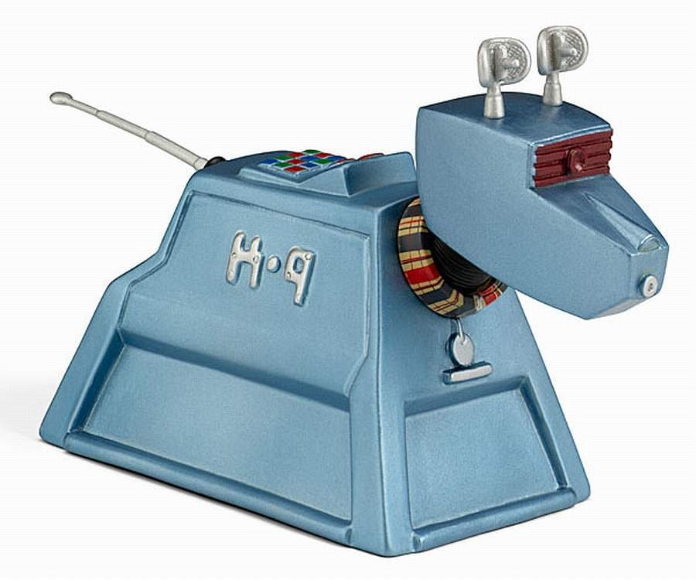
DEMO
Et tu, Digital Watchdog?
gst-launch-1.0 filesrc location=dw-sdes.pcap ! pcapparse ! "application/x-rtcp" ! rtpsession name=rtpsession rtpsession.recv_rtcp_sink ! fakesink
22

Slide 59
UPSTREAM
Some camera-driven fixes of ours, now in GStreamer
RTSP over HTTP with authentication
rtspsrc + rtspconnection
An Axis camera on port 80 rejected the tunnel setup when auth was required. rtspconnection learned to connect-with-response; rtspsrc learned to retry.
Tunneling: relative URIs and x-sessioncookie
rtspconnection
Bosch cameras wanted HTTP/1.0-style relative request URIs and a differently capitalized session cookie header.
Trailing whitespace in RTSP headers
rtspconnection
A camera sent WWW-Authenticate: Digest realm="..." with a trailing space. Auth failed. Now ignored.
Malformed RTCP SDES segfault
rtpsession, rtpbin, rtpjitterbuffer
Bounds checks added in 1.28.4 made get_entry return FALSE; three callers in rtpmanager ignored the return and dereferenced garbage. Digital Watchdog cameras crashed the recorder.
20

Slide 60

PATCHES
Peculiar patches for us alone
A camera that violates a MUST
A grocery chain's in-store cameras send H.264 over RTP with a 300 kHz clock.
21

Slide 61
PATCHES
Peculiar patches for us alone
A camera that violates a MUST
A grocery chain's in-store cameras send H.264 over RTP with a 300 kHz clock.
RFC 6184 section 5.1: "A 90 kHz clock rate MUST be used." rtph264depay's caps say 90000, so nothing links.
21

Slide 62
PATCHES
Peculiar patches for us alone
A camera that violates a MUST
A grocery chain's in-store cameras send H.264 over RTP with a 300 kHz clock.
RFC 6184 section 5.1: "A 90 kHz clock rate MUST be used." rtph264depay's caps say 90000, so nothing links.
- "clock-rate = (int) 90000, "
+ /* [Grocery]Kam v3 transmits RTP referencing a
+ * clock rate of 300 kHz. ... We did not post
+ * an issue to Gstreamer for this since this
+ * camera does not abide by the standard. */
+ "clock-rate = (int) [ 90000, 300000 ], "
21

Slide 63
04
rtspsrc2
What we expect to gain, what stands in the way, and why we haven't switched yet
23

Slide 64
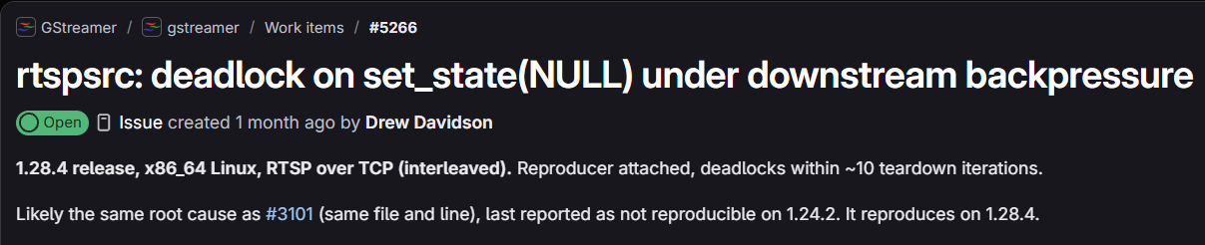
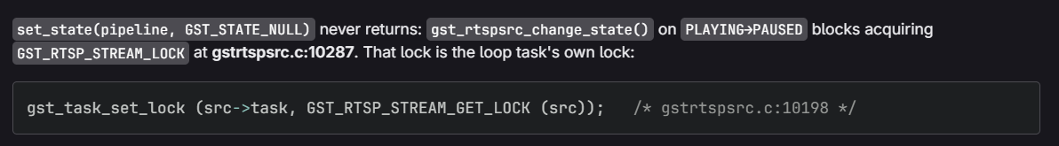
RTSPSRC2
Another Day, Another Bug
24

Slide 65
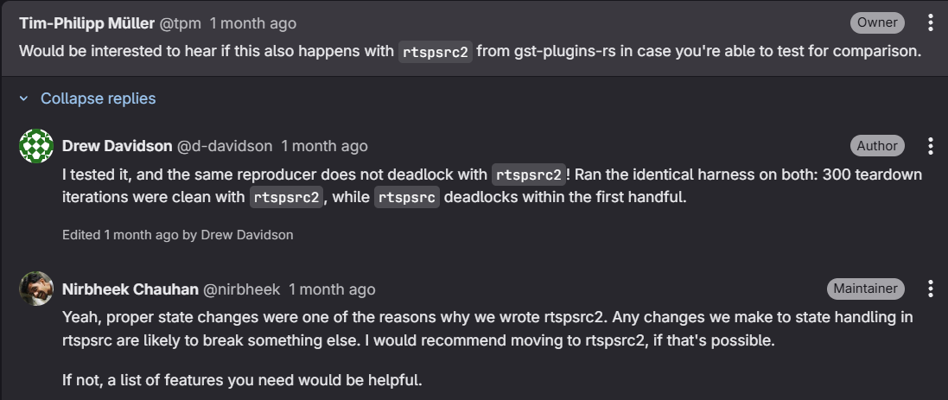
RTSPSRC2
Another Day, Another Bug
24

Slide 66

RTSPSRC2
Why start this thing over?
From the rtspsrc2 README, on the original rtspsrc:
Element states are linked to RTSP states, which causes unfixable glitching and issues, especially in shared RTSP media The command loop is fundamentally broken and buggy, which can cause RTSP commands such as SET_PARAMETER and GET_PARAMETER to be lost The combination of the above two causes unfixable deadlocks when doing state changes due to external factors such as server state, or when seeking
24

Slide 67
RTSPSRC2
Why start this thing over?
From the rtspsrc2 README, on the original rtspsrc:
Element states are linked to RTSP states, which causes unfixable glitching and issues, especially in shared RTSP media The command loop is fundamentally broken and buggy, which can cause RTSP commands such as SET_PARAMETER and GET_PARAMETER to be lost The combination of the above two causes unfixable deadlocks when doing state changes due to external factors such as server state, or when seeking
Parsing of untrusted RTSP messages from the network was done in C with the GstRTSPMessage API Parsing of untrusted SDP from the network was done in C with the GstSDPMessage API
24

Slide 68
RTSPSRC2
Why start this (rtspsrc) thing over?
From the rtspsrc2 README, on the original rtspsrc:
Element states are linked to RTSP states, which causes unfixable glitching and issues, especially in shared RTSP media The command loop is fundamentally broken and buggy, which can cause RTSP commands such as SET_PARAMETER and GET_PARAMETER to be lost The combination of the above two causes unfixable deadlocks when doing state changes due to external factors such as server state, or when seeking | Our recent report of rtspsrc deadlocking in set_state(NULL) under downstream backpressure.
Parsing of untrusted RTSP messages from the network was done in C with the GstRTSPMessage API Parsing of untrusted SDP from the network was done in C with the GstSDPMessage API | Our recent SDES segfault
24

Slide 69
RTSPSRC2
What we use in rtspsrc, and what rtspsrc2 has today
Checked against the current README and imp.rs, not against hope.
HTTP tunnelling (rtsph://)
yes
A transport option our customers choose for restrictive firewalls.
TLS (rtsps://), multicast, keep-alive, credentials
yes
Credentials move from user-id/user-pw properties into the URL. Escaping.
latency, timeout, protocols
yes, different
Defaults 200 ms vs our 100; 5 s vs our 0; protocols is a priority string, which is nicer.
ONVIF backchannel (talkdown)
no
backchannel, select-stream, push-backchannel-sample: none exist.
short-header, force-non-compliant-url
no
The two properties Bosch VIDEOJET and the "IPCAM" population depend on.
NAT hole punching (nat-method)
no
Bosch needed it OFF, so Bosch is fine. Cameras across a NAT on UDP are the exposure.
new-manager signal, rtpbin access
no
Our RTP loss statistics hang off rtpbin's on-new-ssrc. Customer-visible metric.
Not in rtspsrc2 either, but we never set them: do-rtcp, user-agent, buffer-mode, drop-on-latency, tcp-timeout. Our rtspsrc surface is smaller than it looks.
25

Slide 70

RTSPSRC2
Our rtsp2 plan
Backchannel stays on (original) rtspsrc
Contribute properties for quirks
short-header and force-non-compliant-url are small. Perhaps they will become our first rtspsrc2 contributions..
26

Slide 71

RTSPSRC2
Our rtsp2 plan
Backchannel stays on (original) rtspsrc
Contribute properties for quirks
short-header and force-non-compliant-url are small. Perhaps they will become our first rtspsrc2 contributions..
We'll test rtspsrc2 extensively!
Like good GStreamer citizens
On tons of real cameras!
26

Slide 72

RTSPSRC2
Our rtsp2 plan
Backchannel stays on (original) rtspsrc
Contribute properties for quirks
short-header and force-non-compliant-url are small. Perhaps they will become our first rtspsrc2 contributions..
We'll test rtspsrc2 extensively!
Like good GStreamer citizens
On tons of real cameras!
26

Slide 73

Questions?
orchid.ipconfigure.com
28

Slide 74


