Slide 1
Next Generation Display Walls on Linux
Austin Shafer

Slide 2
What is a Display Wall?
Also known as Video Walls, Media Walls, LED walls
Array of displays/projectors arranged to look like one large display
Driven by multiple devices
Wide variety of use cases
  Planetariums
  Attractions/Amusement parks
  Digital signage
  Control centers
Might be irregularly shaped or warped
Most deployments use Windows, we would like to improve Linux usage
GPU 1
GPU 2

Slide 3
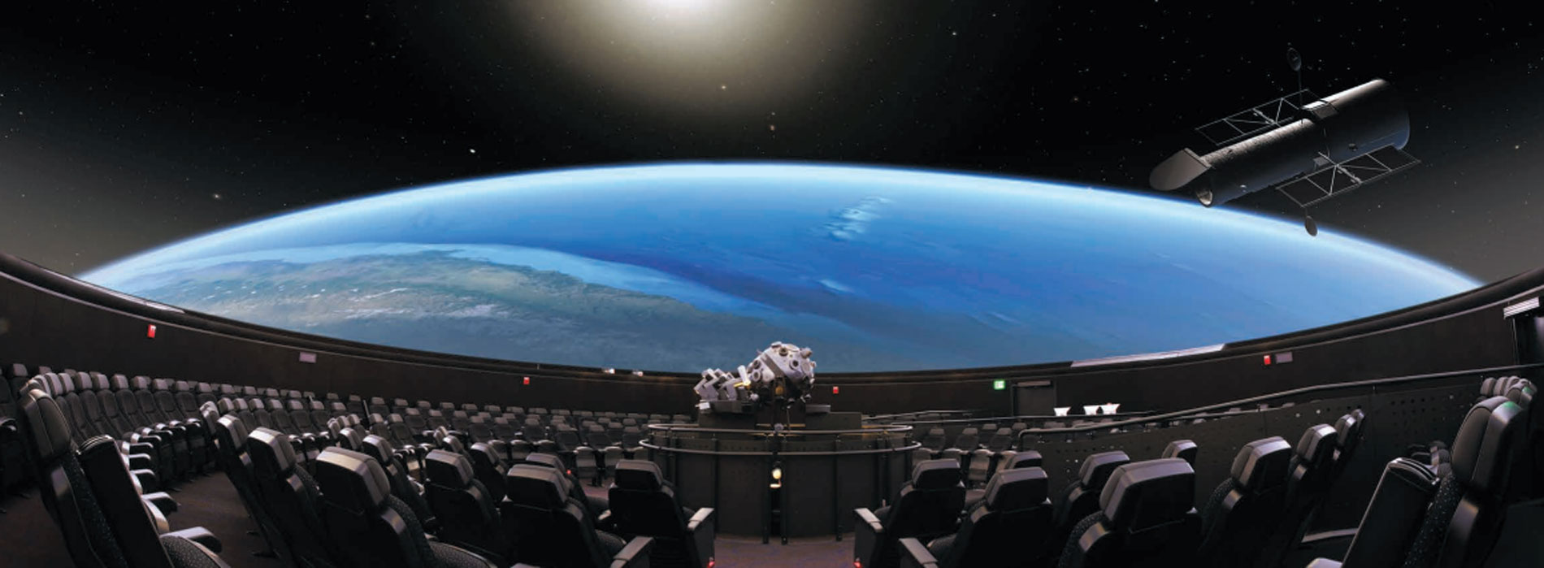
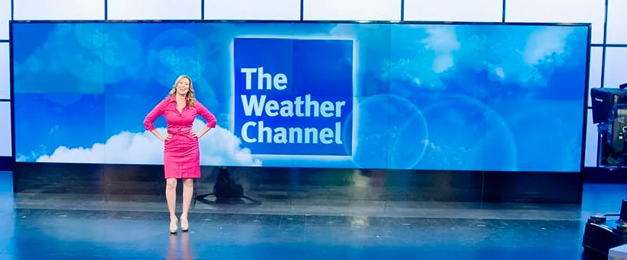

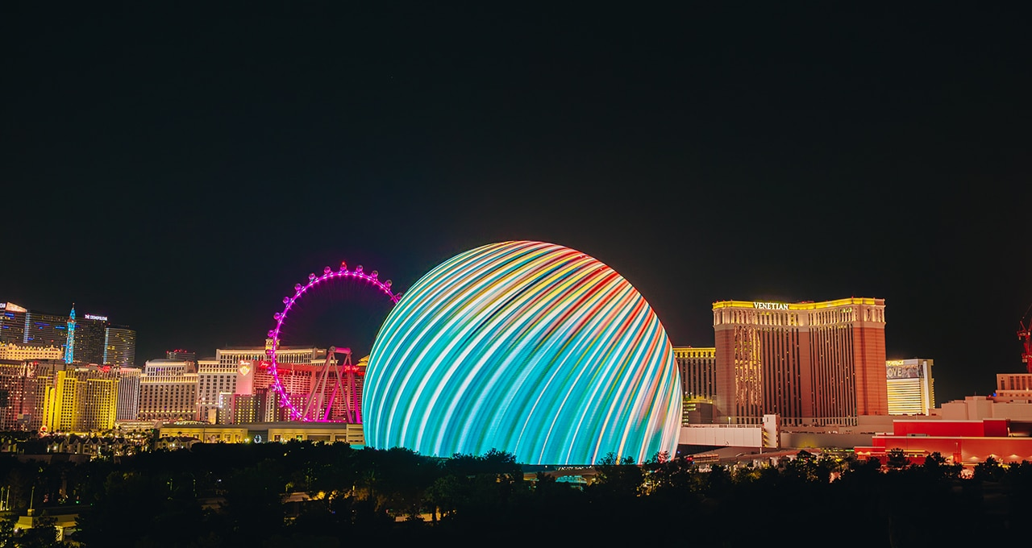
Examples
https://skyskan.com/products/digital-planetarium-systems/
https://www.electrosonic.com/projects/the-weather-channel

Slide 4
Display Wall Challenges
Very different from end-user systems
Multi-GPU or even Multi-system
Synchronized presentation
  Hardware unit provides a synchronization signal to the systems/GPUs
  NVIDIA hardware solution: RTX Pro Sync (aka Framelock, Quadro Sync)
Unique customer setups
Infrequently updated, old kernels
Developers want direct control
  Original implementations were developed before direct display was easily possible. DRM-KMS wasn’t available and everything required a compositor.
gpu1
gpu1
gpu1
System 1
gpu2
gpu2
gpu2
gpu1
gpu1
gpu1
System 2
gpu2
gpu2
gpu2

Slide 5
Display Walls on Xorg
Historic solution for display walls
X11 Application
NVIDIA “Mosaic” displays:
Combine multiple displays into one large virtual surface
Desktop is one large X screen
Implementation lives in NVIDIA X driver, highly Xorg-specific solution
Configured via nvidia-settings and/or xorg.conf
Suits what users need, but ecosystem is migrating away from X
X server
nvidia_drv.so
disp1
disp2
disp3
disp4

Slide 6
Does this design translate to Wayland?
Short answer: not fully
Similar to Xorg design, but with additional challenges:
Keeps Xorg tradeoffs - app doesn’t directly drive displays, compositor has to own them
Shipping an implementation becomes harder
  No cross-compositor method to ship an implementation
  Compositors probably don’t want to be full of vendor-specific display code
This architecture wasn’t what display wall developers wanted originally, so why should we keep forcing it?

Slide 7
Vulkan Direct 2 Display
A wsi type which better fits what display walls want
Vulkan Direct 2 Display (VK_KHR_display) lets a vulkan swapchain drive a physical display without a window system.
Currently recommended solution, lets us:
Direct control of displays, presentation happens in the application
Control fine-grained multi-GPU usage, where and how copies happen
Perform display transformations themselves
Avoid relying on a specific window system
Vulkan D2D Application
Vulkan ICD
VK_KHR_device_group
VK_NV_present_barrier
disp1
disp2
disp3
disp4
Notes:
Vkd2d is the current recommended solution

Slide 8
Vulkan D2D missing pieces
New design has new challenges
Vulkan D2D direct path works well, but still a few problems:
Every application needs logic to handle feature calibration and configuration
  No centralized configuration, configure each application separately
  Applications might not support all features
No seamless continuity between repeated runs of the application
  Performing a modeset may take noticeable time or interrupt display features
How can we improve this? We could have a server which:
Owns the displays
Configures display features
Leases those displays out
Notes:
Problem is current solution lacks seamless transitions and centralized configuration

Slide 9
Display Config Server
https://github.com/NVIDIA/display-config-server
Display Config Server enhances the Vulkan D2D model: the server owns displays and leases them out to Vulkan clients.
Extends current Vulkan D2D solution:
Configuration is now centralized with the server
Seamless handoff between Vulkan D2D applications improves experience
Display feature enablement happens behind the scenes, app doesn’t have to configure or implement anything
Vulkan D2D Applications
Vulkan ICD
Lease protocol
DRM lease
Display Config Server
DRM
disp1
disp2
disp3
disp4
Notes:
DCS is how we want to extend the current vulkan d2d ecosystem

Slide 10
Linux Display Wall Example
Vulkan D2D + DCS
Vulkan D2D Applications
Example deployment:
2 GPUs, 8 displays
Operator uses dcs-tool for configuration once
Vulkan applications acquire displays each run
VK_KHR_device_group drives simultaneous presentation on both GPUs
Vulkan ICD
wp_drm_lease_device_v1
Configuration
commands
dcs-tool
Display Config Server
DRM lease
DRM
GPU 1
GPU 2

Slide 11
Multi-System Example
Multiple DCS and Vulkan instances
System 1
System 2
Vulkan D2D Apps
Vulkan D2D Apps
Vulkan ICD
Vulkan ICD
DCS 1
DRM lease
DRM lease
DCS 2
DRM
DRM
gpu 1
gpu 1
gpu 3
gpu 3
gpu 1
gpu 1
gpu 3
gpu 3
gpu 2
gpu 2
gpu 4
gpu 4
gpu 2
gpu 2
gpu 4
gpu 4

Slide 12
Future work
What’s next?
Support DCS running nested with a Wayland compositor
  Compositor runs on one monitor, leases the remaining displays out
  DCS acquires the displays, configures them, and leases them out to applications
  This makes operating the system a bit easier
We are working on improving how the Vulkan D2D API can present on display walls
Goal is to help improve Linux adoption on display walls

