Slide 1

HDCP Tool Demo
Made By :
Santhosh Reddy Guddati (santhoshguddati@gmail.com)
Suraj Kandpal (suraj.kandpal@intel.com)
Ankit Nautiyal (ankit.k.nautiyal@intel.com)

Slide 2

Objective of the tool
To test if driver is complying to HDCP authentication methodology
This is to recreate a scenario of a real video running and HDCP authentication taking place on it.
It is to test the KMD driver in isolation without the upper stacks in action to see if HDCP is working properly or not.

Slide 3

Basic rules
We have two properties
Content Protection (Undesired, Desired, Enabled)
Content Type (Type 0, Type 1)
Userspace can set
CP to either Undesired -> Desired or Desired -> Undesired
Content Type can be set to 1 only for HDCP 2.x and 0 for both HDCP 1.x/2.x
Driver can set
CP to either from Desired -> Enabled or Enabled -> Desired

Slide 4
How to run the Tool
Clone igt-gpu-tools
git clone https://gitlab.freedesktop.org/drm/igt-gpu-tools.git
Then we will want to install the minimal dependencies to build & run igt-gpu-tools
While in the folder igt-gpu-tools
./build/tools/intel_hdcp

Slide 5
Video Demo

Slide 6
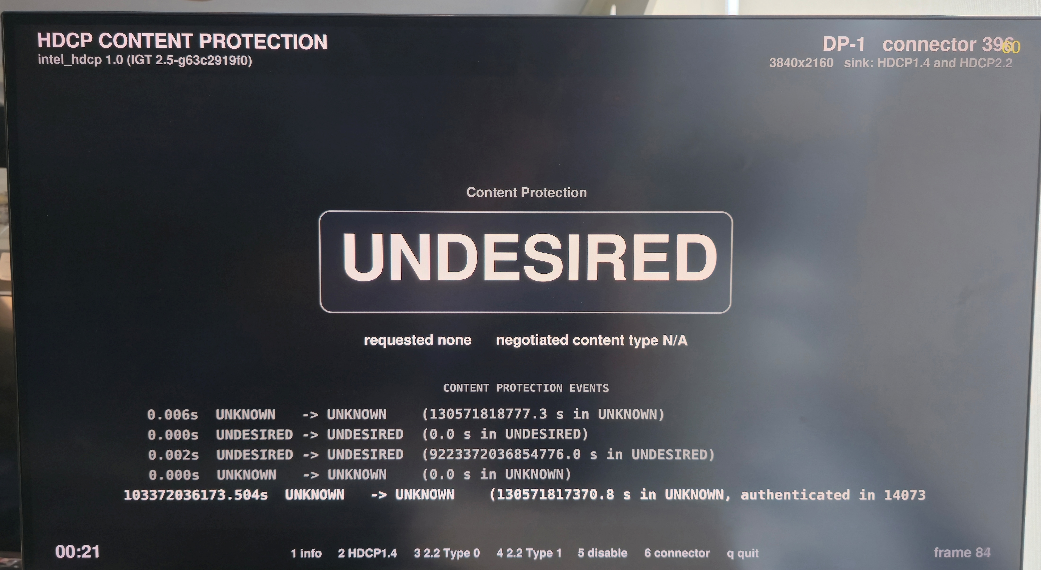

Slide 7
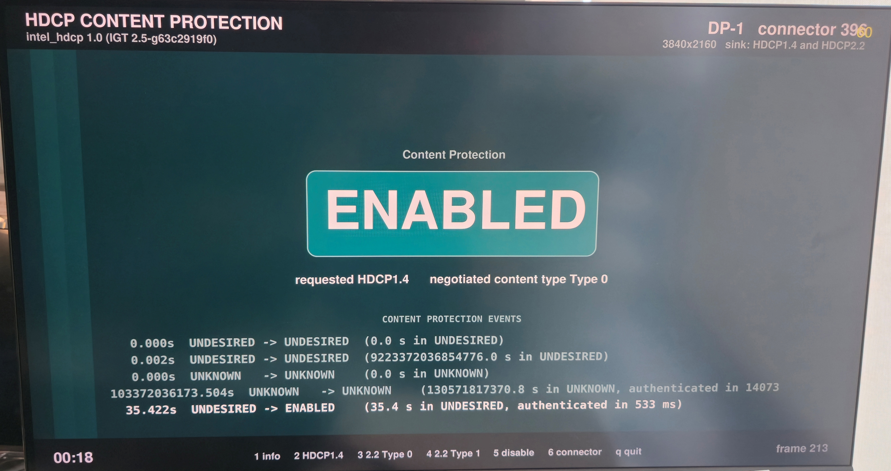

Slide 8
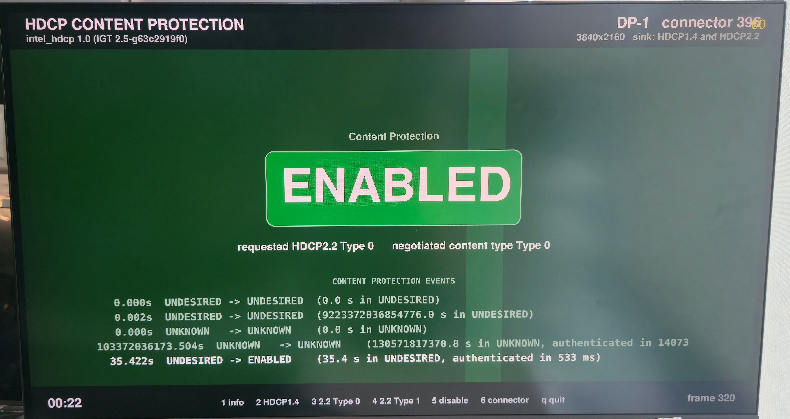

Slide 9
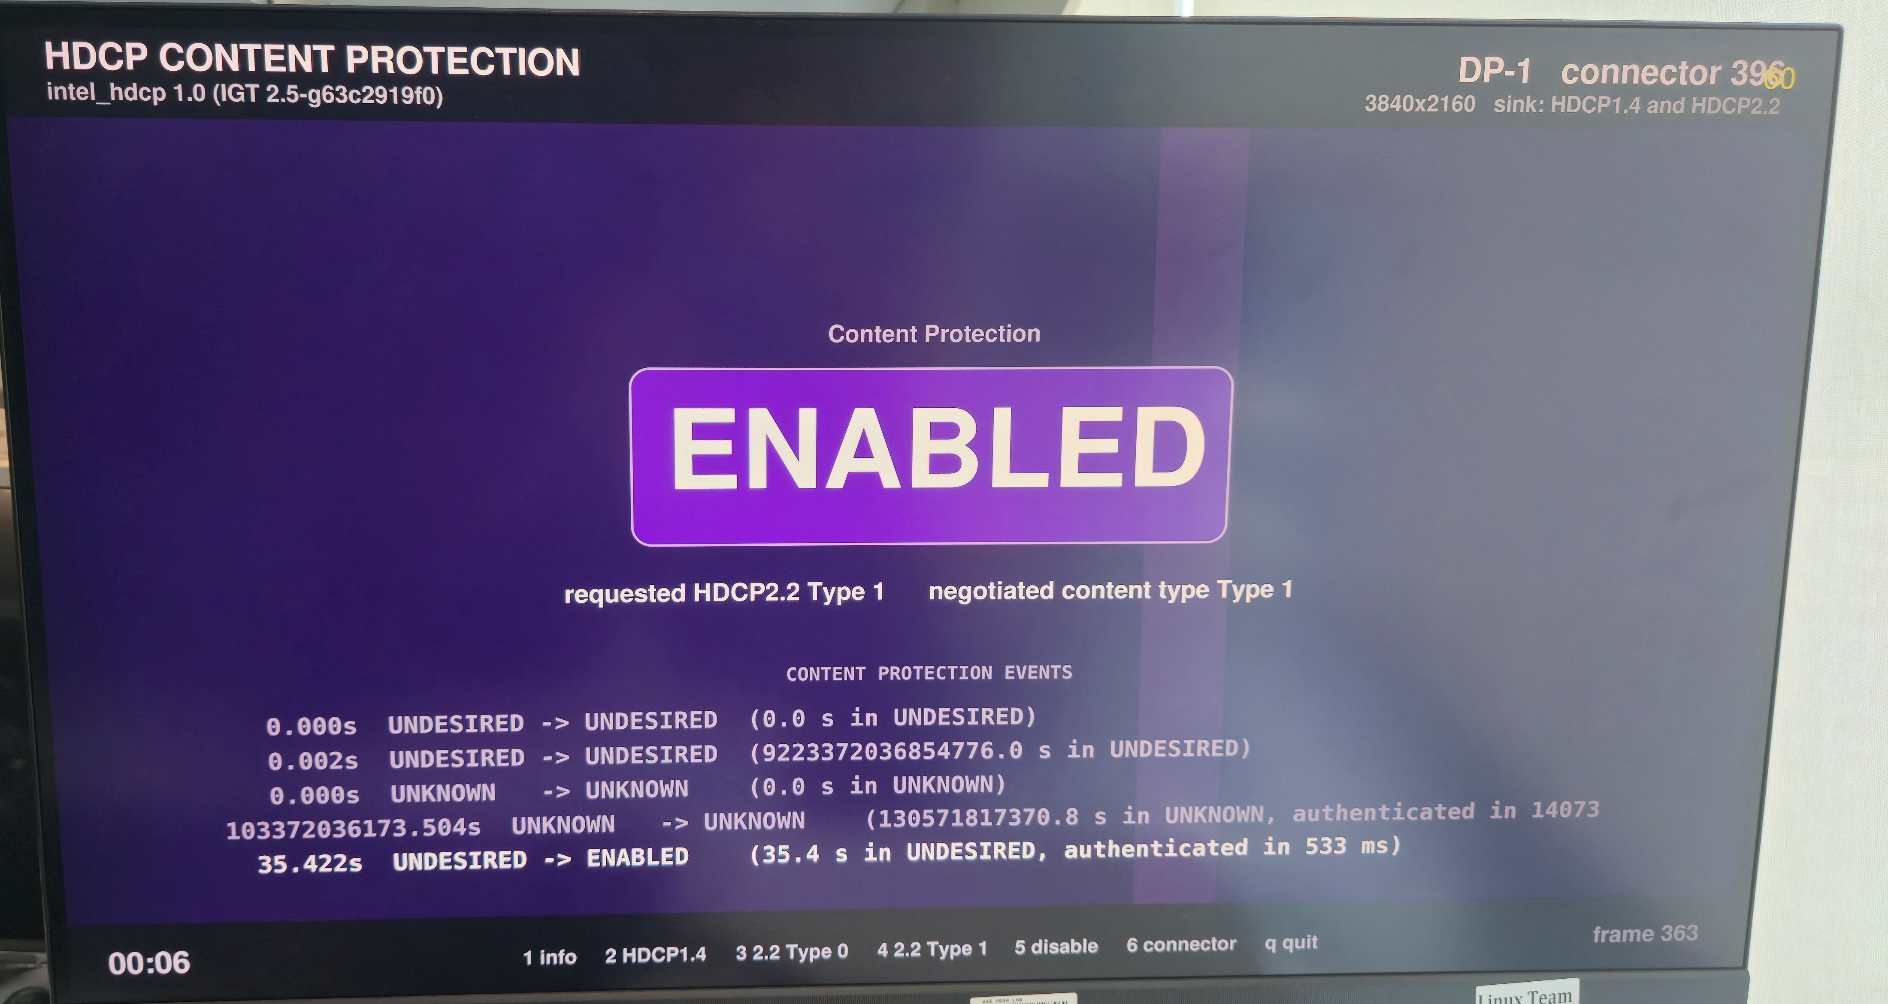

Slide 10
Future plans
Tool to be extended to handle MST
Need to be updated so that it can be used as a compliance testing tool
Update the UI – Series currently under review https://patchwork.freedesktop.org/series/174274/
HDCP Capability uAPI ?

Slide 11
You can find us at
Santhosh Reddy Guddati
  santhoshguddati@gmail.com
  www.linkedin.com/in/santhoshguddati
Suraj Kandpal
  suraj.kandpal@intel.com
  suraj.kandpal18@gmail.com
Ankit Nautiyal
  ankit.k.nautiyal@intel.com

Slide 12
Thank you

