Slide 1
XDC 2026
Error Handling on
Atomic Commit Failure
Arun R Murthy
Yella Ramya Krishna
DRM/KMS UAPI · libdrm · IGT · Mutter · KWin

Slide 2
THE PROBLEM
Atomic commit failures have no specific error codes
Compositor builds
the atomic request
  drmModeAtomicCommit()
Atomic check fails
inside the driver
→
→
Bandwidth Limitation
Modeset requested but
ALLOW_MODESET flag is not set
Async flip request combined with a property change
userspace receives -EINVAL
The compositor is not aware of the specific cause of the failure.

Slide 3
EXISTING APPROACHES
How atomic commit failures are handled
Scrape the kernel log
Offline debugging using dmesg logs.
1
Parse dmesg for a hint about the failure.
Probe with TEST_ONLY
Tells you that it fails, never why. Each probe is another ioctl round trip.
2
Re-run the commit as a test to see whether it would pass.
Blind retry ladder
Based on guess work.
3
Step down resolution, refresh rate, bpc or plane count until something sticks.
Notes:
Today a compositor that hits an atomic commit failure has no information to work with, so it falls back to one of three workarounds — and none of them is reliable.
1. Scrape the kernel log. The driver often does print why it rejected the commit, but only to dmesg. That is a debugging aid, not an interface: it is free-form text, it changes between drivers and kernel versions, and in most production setups the compositor cannot even read it. Useful offline, useless at runtime.
2. Probe with TEST_ONLY. The commit can be re-run as a test to see whether it would pass. That tells you it fails — it never tells you why. And every probe is another ioctl round trip, so the cost grows with the number of things you want to rule out.
3. Blind retry ladder. This is what most compositors actually do: step down resolution, then refresh rate, then bpc, then plane count, until something sticks. It is pure guesswork over a large search space. The user sees it as a delay — or as a black screen if the ladder runs out.
The common thread: all three are trying to reconstruct information the kernel already had and simply did not pass back. That is what the rest of the talk is about.

Slide 4
ATOMIC COMMIT FLOW
Passing failure information to userspace
Compositor builds the atomic request
↓
drmModeAtomicCommit()
↓
Driver atomic check rejects it → -EINVAL
-EINVAL + failure_code + failure reason + drm objects causing the failure
↓
libdrm exposes this information to compositor
Compositor adjusts the request and retries
Compositor decodes it, add the corrective measures to the drm object and retries
↓
Display update succeeds
Existing Atomic Commit
Atomic Commit with Error Handling

Slide 5
EXAMPLE SCENARIO
Bandwidth limitation
Two 4K panels connected
Atomic request demanding more bandwidth
Higher mode / Down scaling / Increase number of overlay planes / Tiling
Driver hits the bandwidth limit
WHAT USER SPACE NOW RECEIVES
-EINVAL + DRM_MODE_ATOMIC_SCANOUT_BW + Bandwidth exceeded + drm objects that caused it
The retry is straightforward
The compositor can adjust the config and retry.

Slide 6
DEVELOPMENT
How the error travels: mutter → libdrm → kernel
Mutter
libdrm
Kernel
THE NEW STRUCTURE
drmModeAtomicCommit(req)
struct drm_mode_atomic_err_code {
__u64 failure_code;
__u64 failure_objs_ptr;
__u32 count_objs;
char failure_string[];
__u64 reserved;
};
DRM_IOCTL_MODE_ATOMIC
If atomic commit check fails
Driver fills drm_mode_atomic_err_code
WHAT EACH FIELD CARRIES
Returns -EINVAL
failure_code
Which failure occurred
if (DRM_CAP_ATOMIC_ERROR_REPORTING)
drmModeAtomicGetErrorCode()
failure_objs_ptr / count_objs
The objects at fault
failure_string[]
Optional readable detail
Get error code information
reserved
Room to extend the ABI
Invokes the matching fallback and retries
Green
- New API
- Existing Code
Blue

Slide 7
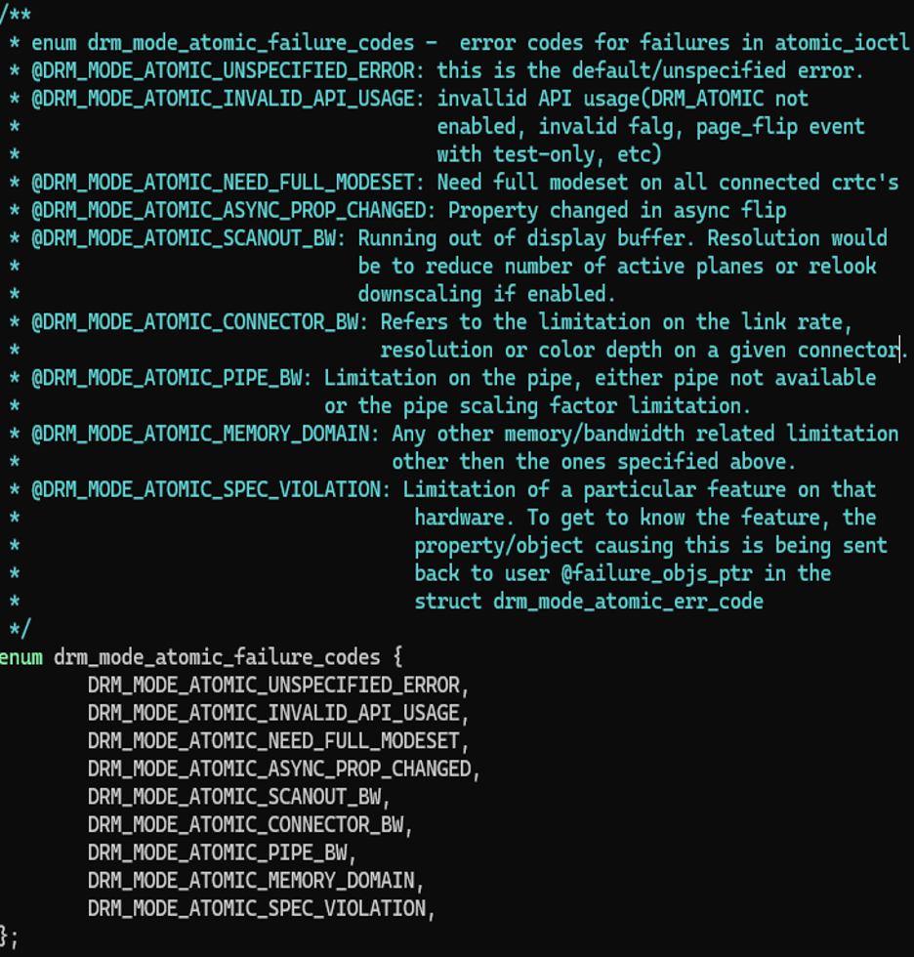
ERROR CODES
The failure codes the driver reports

Slide 8
LINKS
References
2025 Display Next Hackfest
Kernel series
hackmd.io/f3bDn3kyRUalLn4LbMfCVQ
patchwork.freedesktop.org/series/152275
IGT series
libdrm MR
patchwork.freedesktop.org/series/153330
https://gitlab.freedesktop.org/mesa/libdrm/ MR !450
Mutter RFC
KWin MR
https://gitlab.gnome.org/GNOME/mutter/ MR !5022
invent.kde.org/plasma/kwin MR !8991

Slide 9
Thank you
CONTACTS
Arun R Murthy
Yella Ramya Krishna
XDC 2026 · Error Handling on Atomic Commit Failures

