Slide 1
GStreamer at Scale: Recent Lessons from Real-World Video Conferencing
Håvard Graff - havard@pexip.com

Slide 2
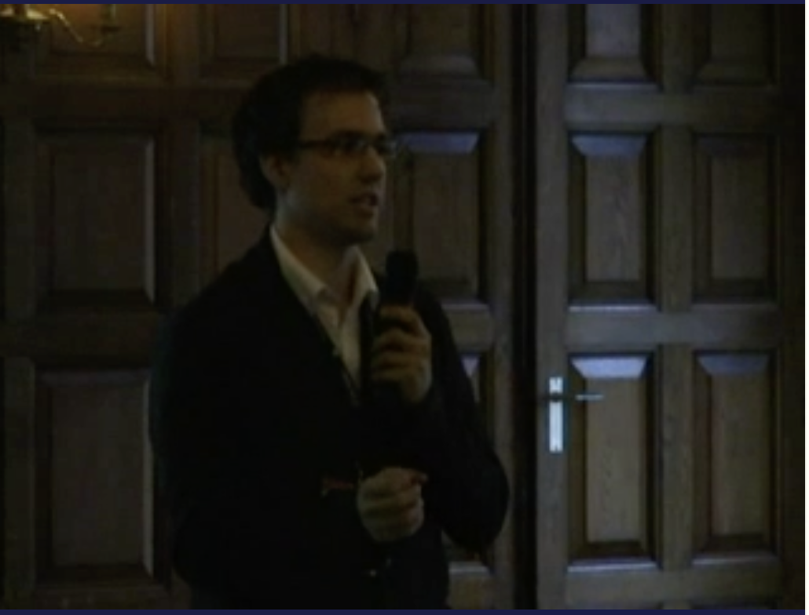
Notes:
My name is Håvard
– working professionally with GStreamer for 18(1) years now
Me presenting at the first Gstreamer Conference 2010
Look at that guy – yet to be a father and yet to work with jitterbuffer timers

Slide 3

Pexip
Started in 2012
Video-conferencing technology
Uses Gstreamer for «everything»

Slide 4


















Pexip at-a-glance
Software only specialist video conferencing player
Serving large enterprises and public sector organizations
2012
+300
25
founded
employees
countries
Unique technology
A market leading interoperability and secure video meetings provider
Software only
We develop and deliver software
Global alliances
Unique partnerships with the technology leaders in our industry
We partner with the global industry leaders to complement their solutions
Serving large global organizations
Across enterprise and public sector
$ 119 million
in Annual Recurring Revenue (ARR)

Slide 5
“What have Pexip been doing with GStreamer lately”
Håvard Graff - havard@pexip.com
Notes:
5 min!

Slide 6
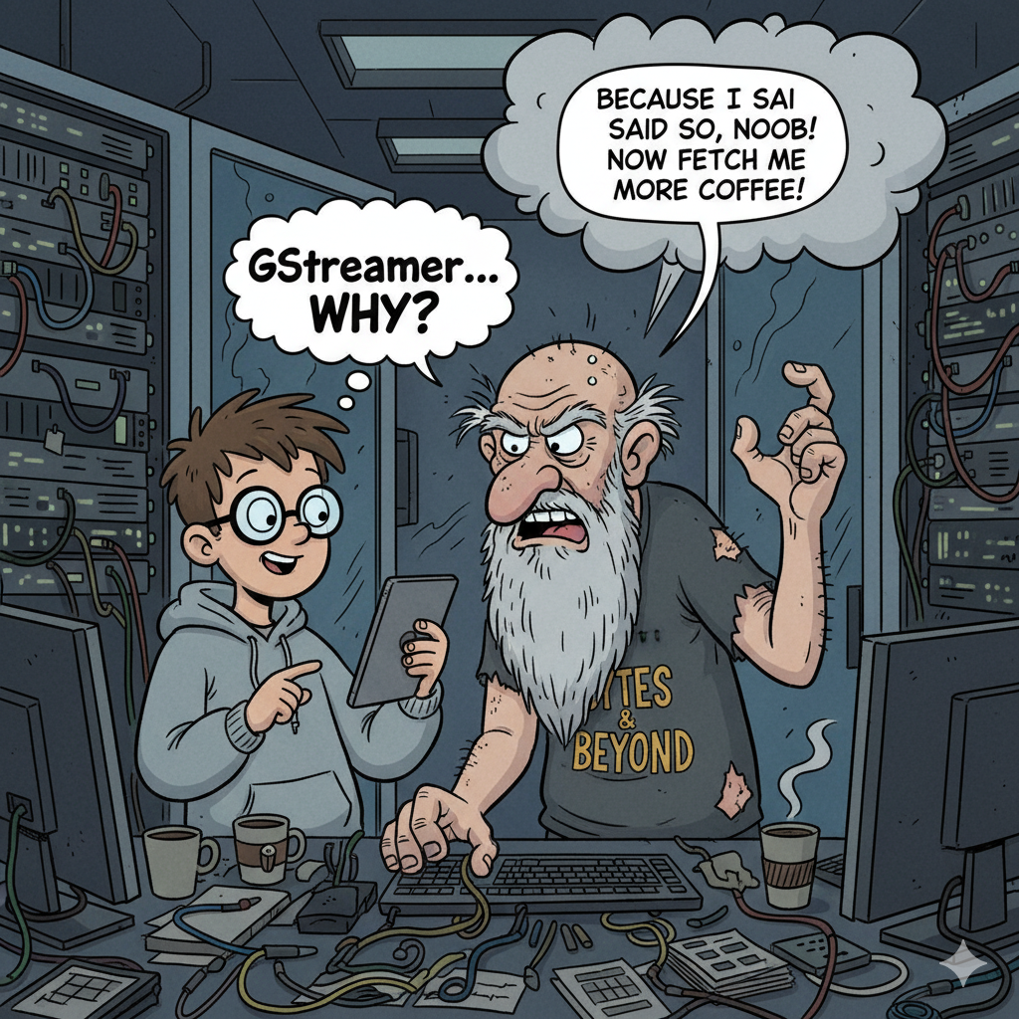
But first...
«Why do we use GStreamer?»

Slide 7
My top arguments!
Encapsulation!
  Makes things easier to test!
    Improves quality!

Slide 8


Slide 9
Also... some news!
Pexip is moving GStreamer (back) to the device!
Let me explain:
Notes:
5 min

Slide 10







Pexip running on linux!
Datacenter 1
Pexip Mgmt Node
Infinity Connect User
WebRTC User
Infinity Connect User
WebRTC User
Pexip Edge 1
Pexip Conf Node 1
Infinity Mobile User
Infinity Mobile User
Pexip Edge 2
OTJ
Pexip Conf Node 2
Datacenter 2
SIP/H323 VC endpoints
SIP/H323 VC endpoint
Internet
DMZ
LAN
Notes:
Pexip Infinity distributed architecture is purely software-based and virtualized,
A Pexip Infinity deployment, regardless of size, has just one Management Node. The purpose of the Management Node is to create and manage Conferencing Nodes
Benefits:
Centralized management
Ability to deploy conferencing resources where and when required, without service outage
Ability to deploy dedicated Proxying Edge Nodes to handle all external connections, and leave the conference media processing to privately-addressed Transcoding Conferencing Nodes
Increased resilience to temporary network outages
You can easily scale a deployment up by creating several Conferencing Nodes in the same location (i.e. the same datacenter). Capacity can even be added “on the fly” – Conferencing Nodes can be added in a couple of minutes if more capacity is needed. Alternatively, each location can be configured to overflow to another location if it reaches its capacity, including bursting to temporary resources on a cloud service.
When two or more Transcoding Conferencing Nodes are hosting the same conference, they send the call media between each other over a secure IPsec backplane.

Slide 11





Pexip running on windows!
Teams clients
SfB clients
SfB Edge
SfB FEP & AV-MCU
Surface Hub / SRS
Pexip Mgmt Node
H323 VC endpoint
OTJ
Pexip Edge Node
Pexip Conf Node
SIP/H323 VC endpoint
SIP VC endpoint
External B2B Federation & cloud
DMZ
LAN
Notes:
Adding Microsoft Teams will be same as the previous deployment with the addition of the Teams GW in Azure.

Slide 12
Pulse
Pexip Unified Library for Secure Engagement (thanks ChatGPT!)
Moving our GStreamer media stack to devices
  Finally talking to ourselves!
…hence our patches on iOS, Android, Windows and MacOS…

Slide 13
Menu:
pexLGPL bundle – (lightning talk by Tulio yesterday)
GstBaseIdleSrc – (Camilo will present today @ 12:50)
dcsctp – (Tulio will present today @ 16:05)
Device stuff…
SRC’es and SINK’s
TWCC
Some fun optimizations!
“The autoremove story”
Notes:
10 min

Slide 14
Device stuff...
osxaudiodeviceprovider – major upgrade!
alsadeviceprovider – bug fixes
wasapi - bug fixes
mediafoundation - *lots* of fixes
v4l2deviceprovider – fixes
avfdeviceprovider – introduced device monitoring
avaudiodeviceprovider – new implementation!
vtenc/vtdec – bug fixes (deadlocks!)
amcvideoenc – lots of fixes
acamdeviceprovider – new implementation!
amdeviceprovider – new implementation!

Slide 15
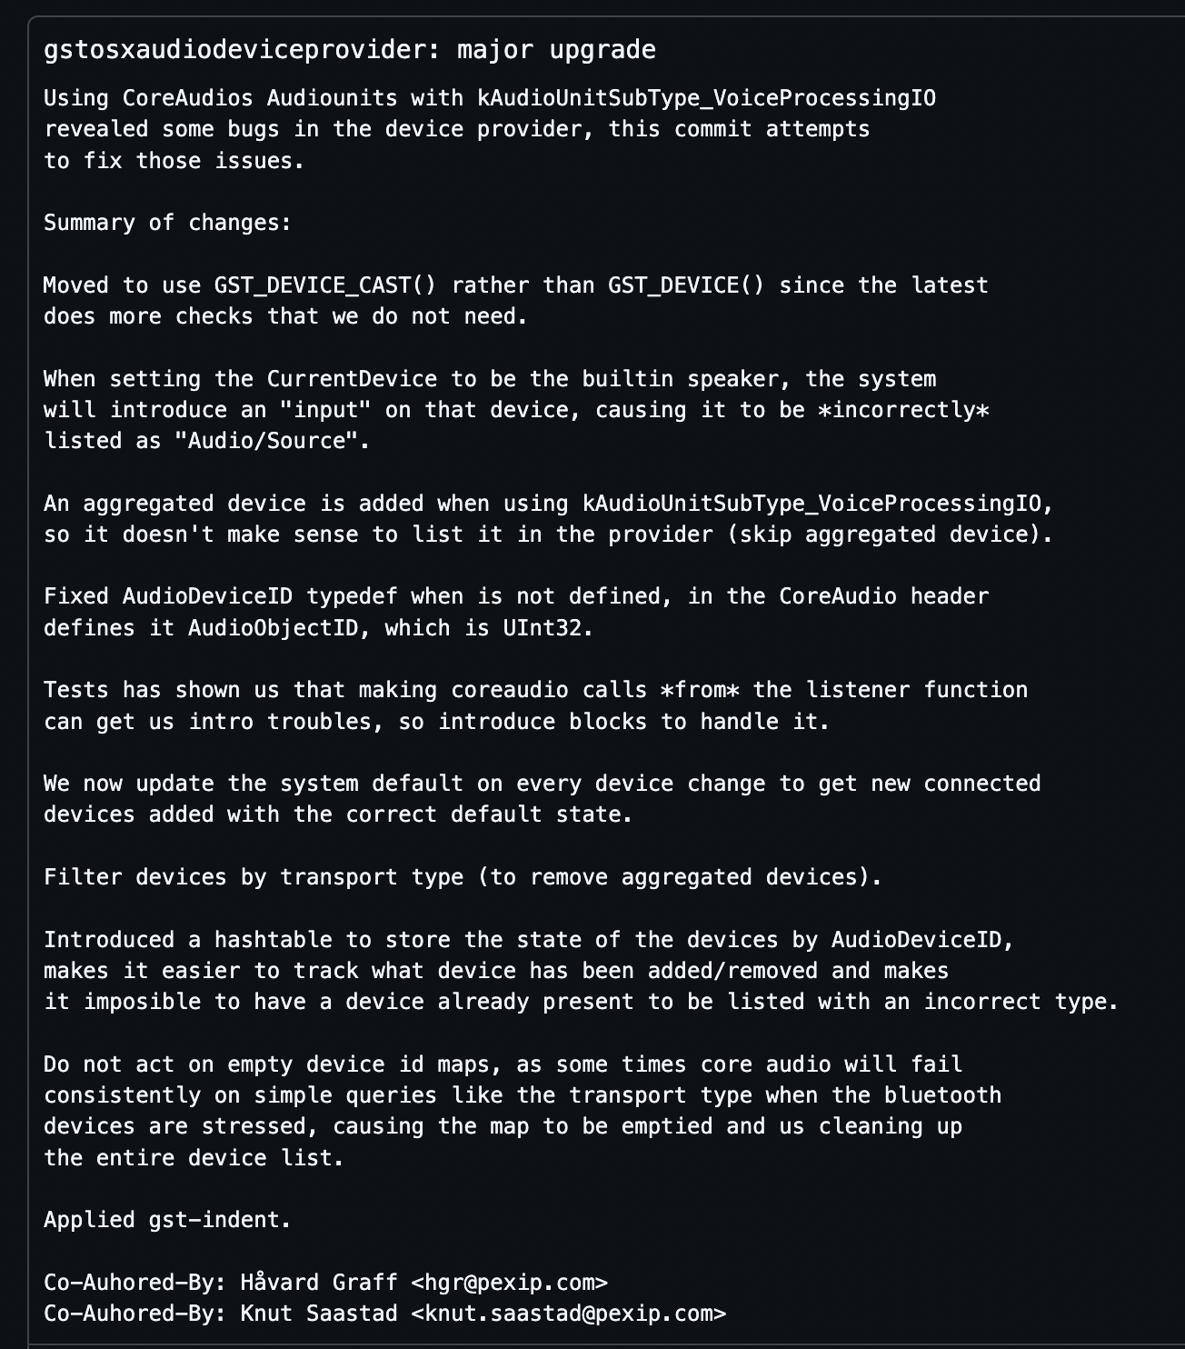
https://github.com/pexip/gstreamer/commit/3cf3d30a9667e6354e83f9c78123e5050eeb6195
Notes:
20min

Slide 16
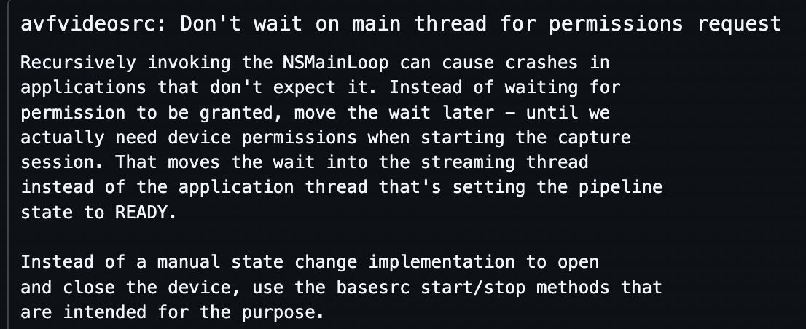
SRC’es and SINK’s
We rescued ahc2src! (Justin Kim justin.kim@collabora.com)
  Made it usable on android!
avfvideosrc – fixes and a revert (!?!) ->
mfvideosrc – fixes
mfcapturewinrt – fixes
mfsourcereader – fixes
metalsink – new implementation
avfvideosink – new implementation

Slide 17
TWCC
https://gstconf.ubicast.tv/videos/google-transport-wide-congestion-control/
Lots of changes to stats!
  How we generate stats!
  New (and cool) stats!
Support for Recovery Percentage with FEC
  ”What has the receiver conceivably recovered”
  Great metric for differentiating “congestion” <-> “static packets loss”
  ”Easy” for RTX, complicated for FEC
  New RTPRepairMeta!
Notes:
20

Slide 18
Some fun optimizations!
(should this take 1 minute?)
GST_START_TEST (gstelement_test_add_remove_pad_performance)
{
gint num_pads = 100000;
GstElement *el = gst_element_factory_make ("identity", NULL);
GstPad **pads = g_new0 (GstPad *, num_pads);
gint i;
gint64 t[4];
for (i = 0; i < num_pads; i += 2) {
gchar *srcname = g_strdup_printf ("src-%d", i);
gchar *sinkname = g_strdup_printf ("sink-%d", i);
pads[i + 0] = gst_pad_new (srcname, GST_PAD_SRC);
pads[i + 1] = gst_pad_new (sinkname, GST_PAD_SINK);
g_free (srcname);
g_free (sinkname);
}
t[0] = g_get_monotonic_time ();
for (i = 0; i < num_pads; i++) {
gst_element_add_pad (el, pads[i]);
}
t[1] = g_get_monotonic_time ();
for (i = 0; i < num_pads / 2; i++) {
gst_element_remove_pad (el, pads[i]);
}
t[2] = g_get_monotonic_time ();
for (i = 0; i < num_pads / 2; i++) {
gst_element_remove_pad (el, pads[num_pads - i - 1]);
}
t[3] = g_get_monotonic_time ();
for (i = 0; i < 3; i++) {
double dur = (t[i + 1] - t[i]) / (double) G_TIME_SPAN_SECOND;
GST_ERROR ("stage %d took %lf seconds", i, dur);
}
g_free (pads);
gst_object_unref (el);
}
GST_END_TEST;

Slide 19
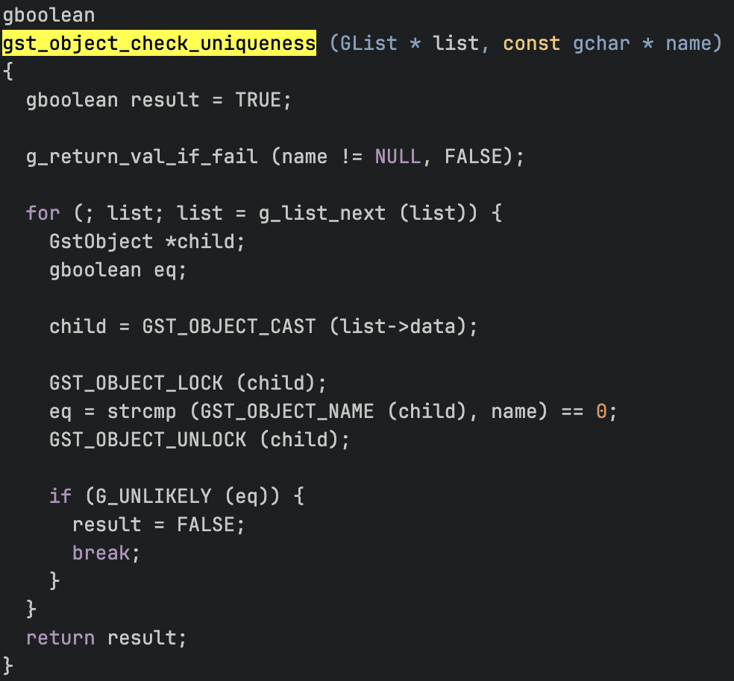
Problem 1:

Slide 20
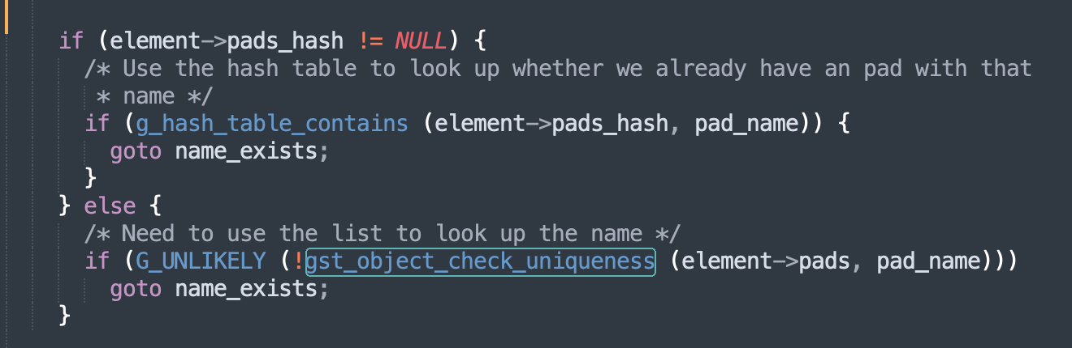
Solution: (GHashTable)

Slide 21
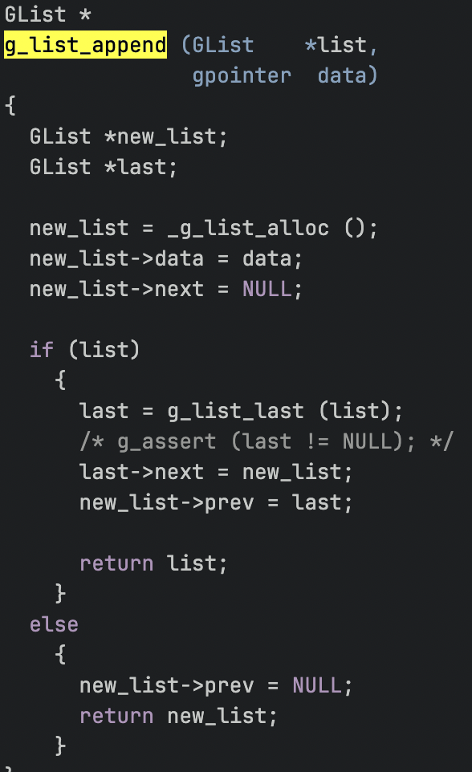
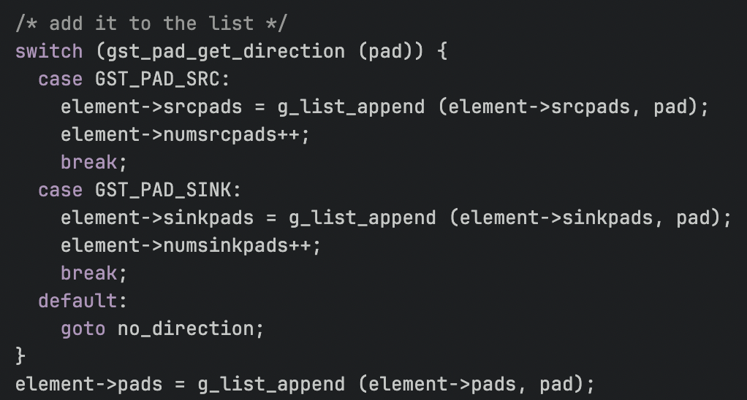
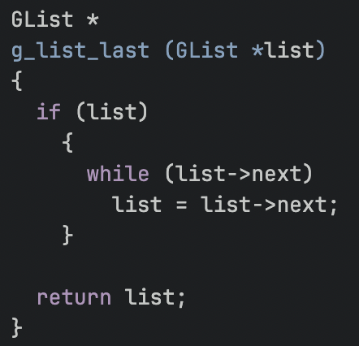
Problem 2:

Slide 22
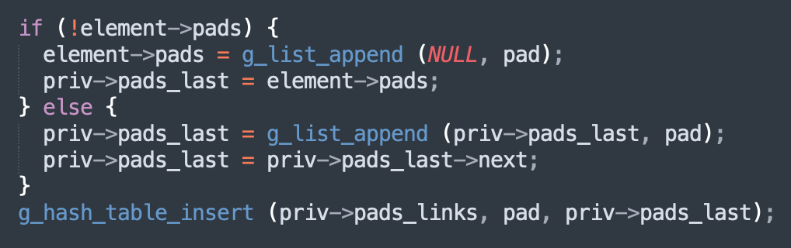
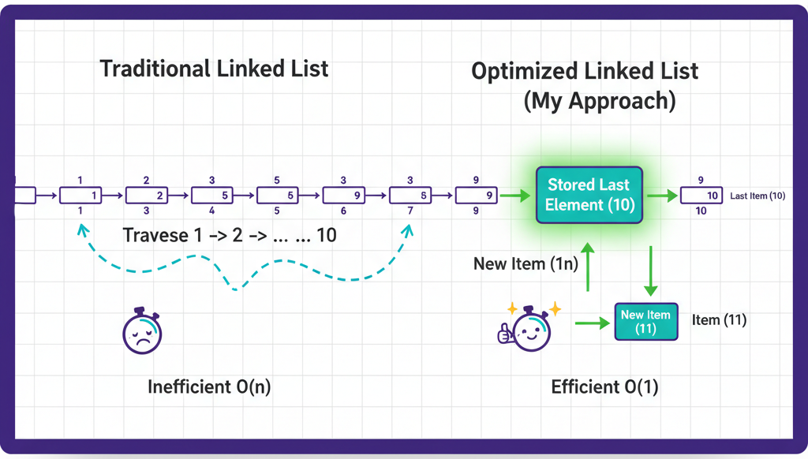
Solution: «keep the last»

Slide 23
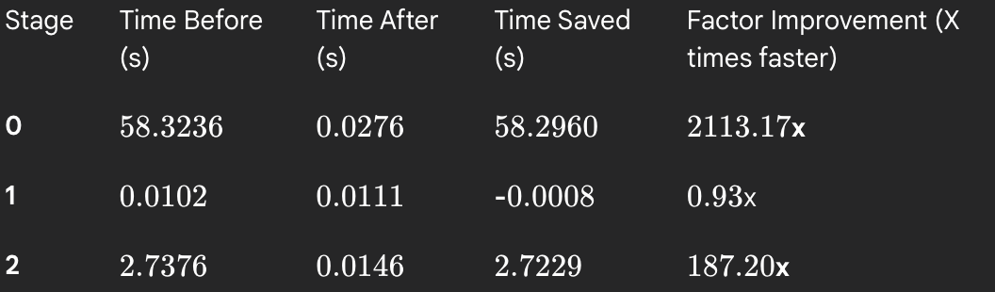
Results:
Notes:
22min

Slide 24
How long should this take?
(pushing 1000 events upstream on a 10.000 pad funnel)
GST_START_TEST (test_funnel_send_upstream_event_performance)
{
gint num_pads = 10000;
GstHarness *h =
gst_harness_new_with_padnames ("funnel", NULL, "src");
GstHarness **sinks = g_new0 (GstHarness *, num_pads);
gint i;
gint64 t[2];
double dur;
for (i = 0; i < num_pads; i ++) {
gchar *sinkname = g_strdup_printf ("sink_%d", i);
sinks[i] =
gst_harness_new_with_element (h->element, sinkname, NULL);
g_free (sinkname);
}
t[0] = g_get_monotonic_time ();
for (i = 0; i < 1000; i++) {
gst_harness_push_upstream_event (h,
gst_event_new_custom (GST_EVENT_CUSTOM_UPSTREAM,
gst_structure_new_empty ("test")));
}
t[1] = g_get_monotonic_time ();
for (i = 0; i < num_pads; i ++) {
gst_harness_teardown (sinks[i]);
}
dur = (t[1] - t[0]) / (double) G_TIME_SPAN_SECOND;
GST_ERROR ("pushing events took %lf seconds", dur);
gst_harness_teardown (h);
}
GST_END_TEST;;
Notes:
23min

Slide 25
pushing events took 123.776537 seconds

Slide 26
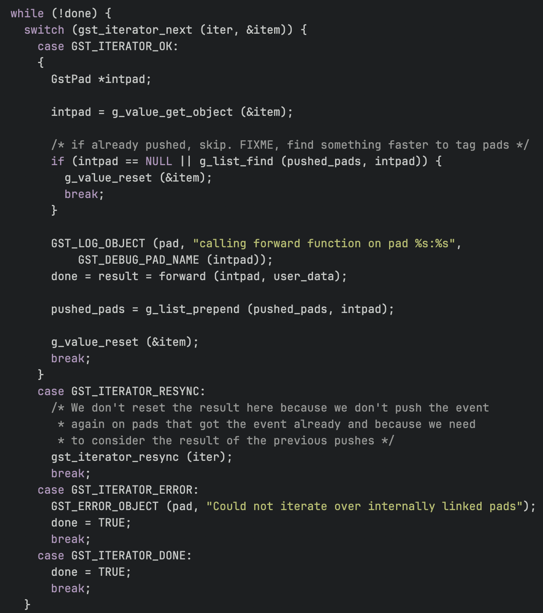
gst_pad_forward ()
perf showing gst_pad_forward() taking most cycles
Every iteration push on a pad
Store pads pushed on in “pushed_pads”
Check if the current pad are in “pushed_pads”
  Why?
    Don’t push on same pad twice!
  Seems silly?
    FIXME!
  How can it happen?
    RESYNC!
So why not just do:

Slide 27
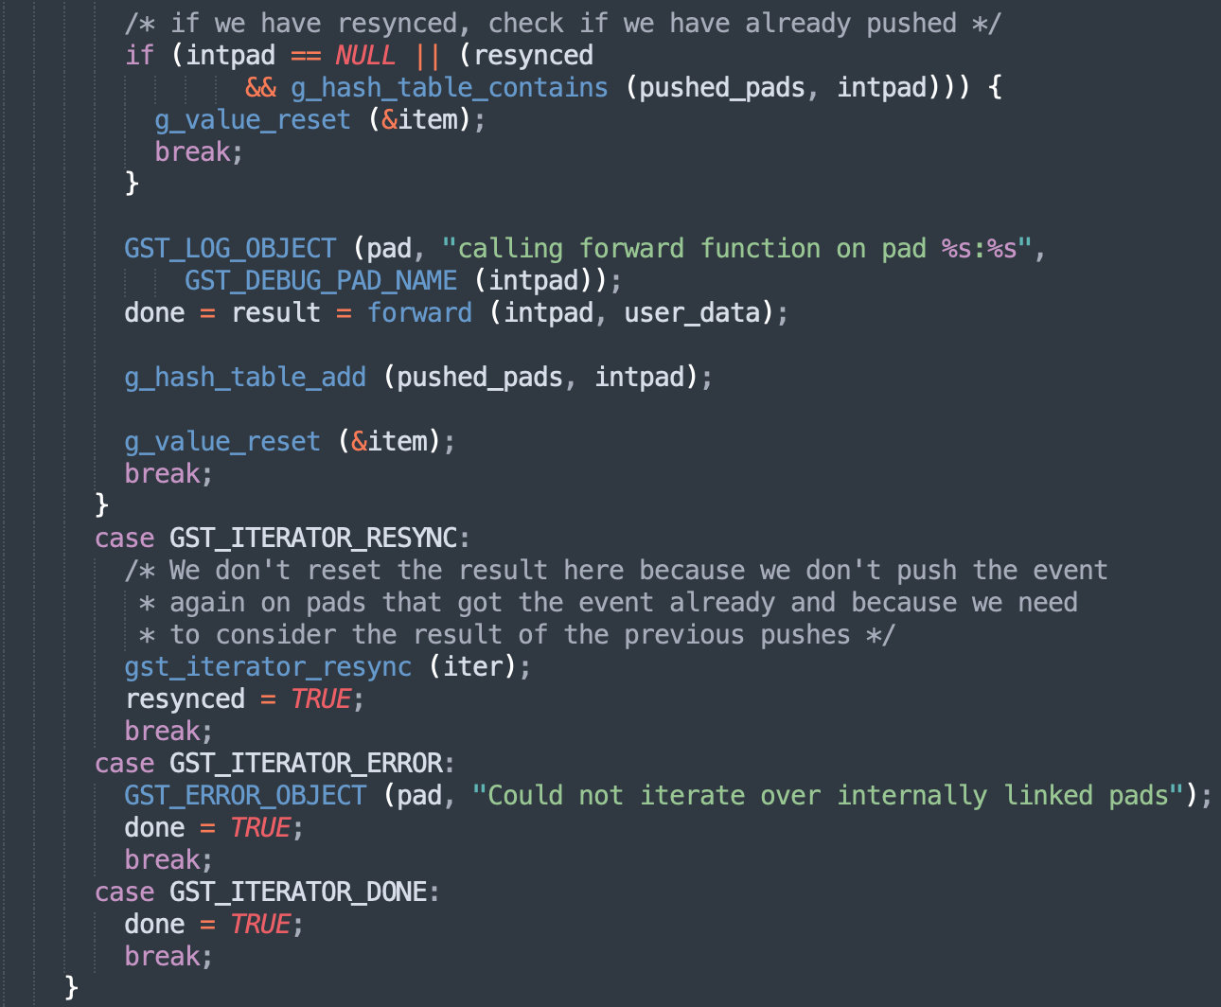

Slide 28
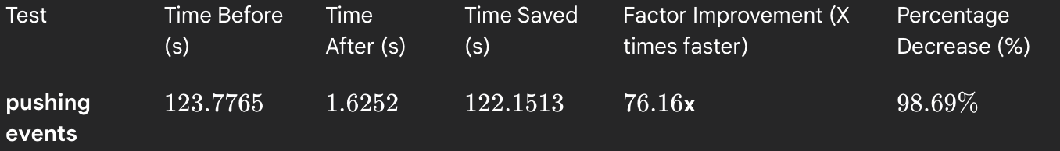
Results:
Notes:
25 min

Slide 29
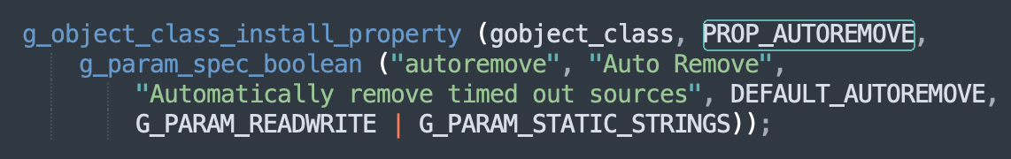
“The autoremove story”
We have lots of streams coming and going
Could they remove themselves when inactive?
Let’s try “autoremove” in gstrtpbin:
Notes:
27 min

Slide 30


Slide 31
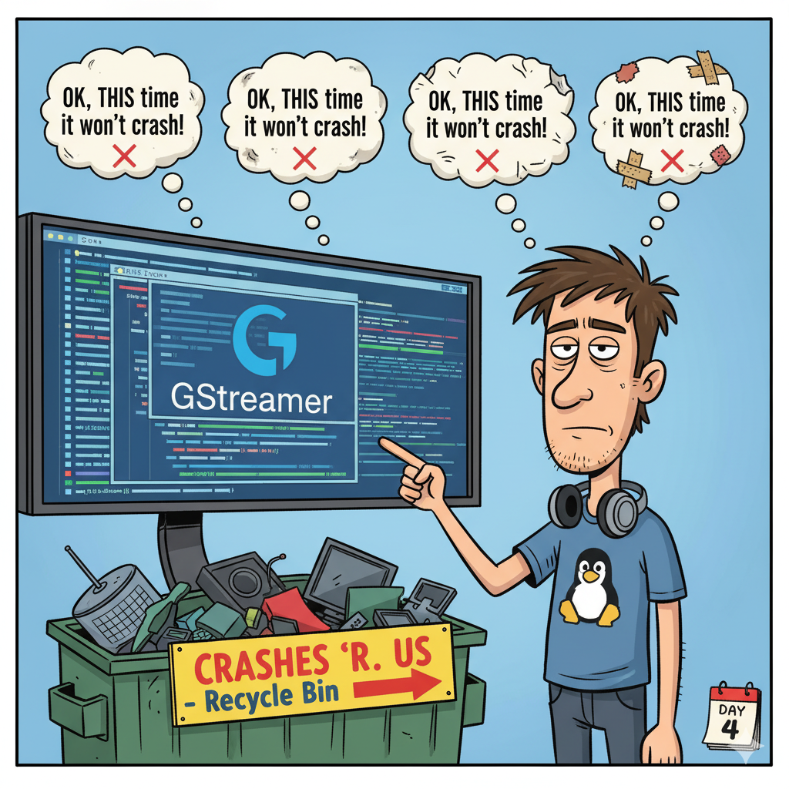

Slide 32
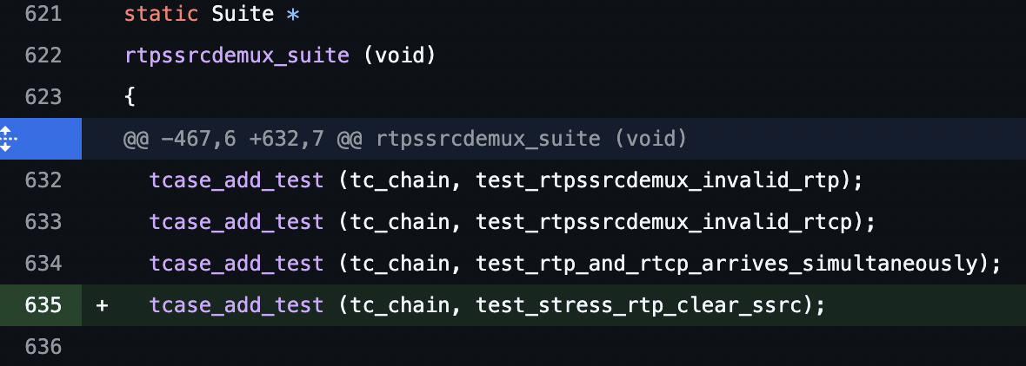
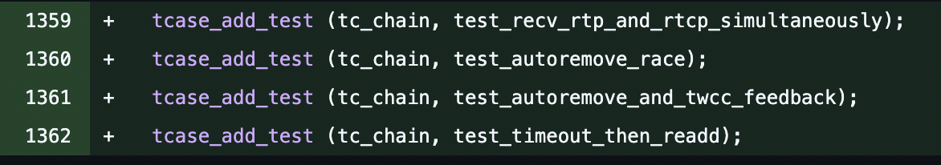
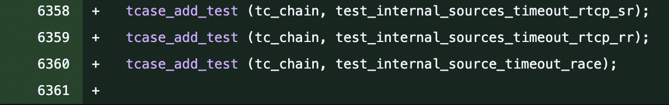
Tests!!

Slide 33
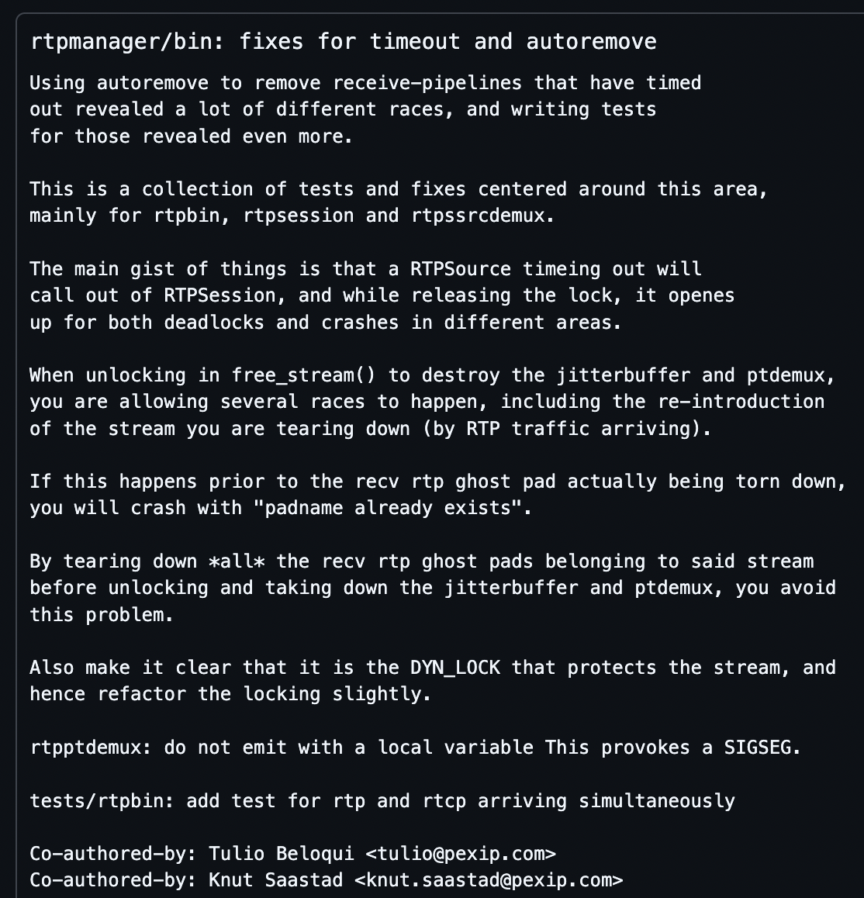
Fixes:
rtpbin:
  Completely revised all locking
  Tracking ptdemux-pads differently
rtpsession
  include packet-type in obtain_source()
rtpptdemux:
  fix a race-condition concerning payload type in signal
rtpssrcdemux:
  Revised locking

Slide 34

In the end:
Notes:
35

Slide 35
Thank you!
  https://github.com/pexip/gstreamer/
  Go see Tulio and Camilo’s talks!
  See you @ hackathon!

