Slide 1
Wltest
automating wayland client & driver testing
Austin Shafer

Slide 2
What is wltest
Open source Wayland test suite:
https://gitlab.freedesktop.org/ashafer/wltest
Tests include resize, minimize, maximize, fullscreen
Coverage includes:
EGL, GLX, Vulkan
Wayland and Xwayland
Supports running predefined tests on custom applications
Does not require custom compositor builds
Detects if test crashes or hangs

Slide 3
Why do we need a new test suite?
Motivation
Wlcs - https://github.com/canonical/wlcs
Requires compositor integration
Really more of a test framework for compositors, not clients
xwayland-run - https://gitlab.freedesktop.org/ofourdan/xwayland-run
Headless only
No true xdotool cross-compositor equivalent on Wayland for us to automate testing

Slide 4
How wltest is different
Requirements
Not headless
We want to exercise the presentation pipeline
No custom compositor builds
Validate tests pass in a normal user’s setup
Can run tests with arbitrary programs
Useful for testing resize of less common apps
Coverage of Vulkan, EGL, Wayland, Xwayland

Slide 5
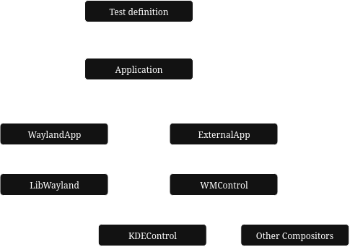
Design
How we avoid requiring custom compositors
Tests are defined and manipulate an Application
Perform a resize to 64x64 without knowing program details
Application can either be:
A window created by wltest itself
An external application (vkcube, glxgears, etc)
Having a common library for compositor controls would be useful

Slide 6
Future Work
And potential uses of wltest
Support more compositors
External application support is currently limited to KDE
More test cases
Output validation
Currently wltest only verifies that the program changes size and does not crash
Trickier than it seems, how can you reliably verify the on-screen contents are correct?
Please reach out, we want to collaborate

