Slide 1

Content Protection on Linux
Suraj Kandpal (suraj.Kandpal@intel.com)

Slide 2
Agenda
What & Why Content Protection ?
HDCP
HDCP & PAVP
PAVP
Challenges & the downsides of CP
Content Protection Adoption
HDCP1x Vs HDCP2.x
HDCP from userspace to driver
Types Of Content Protection
Content Protection Adoption

Slide 3
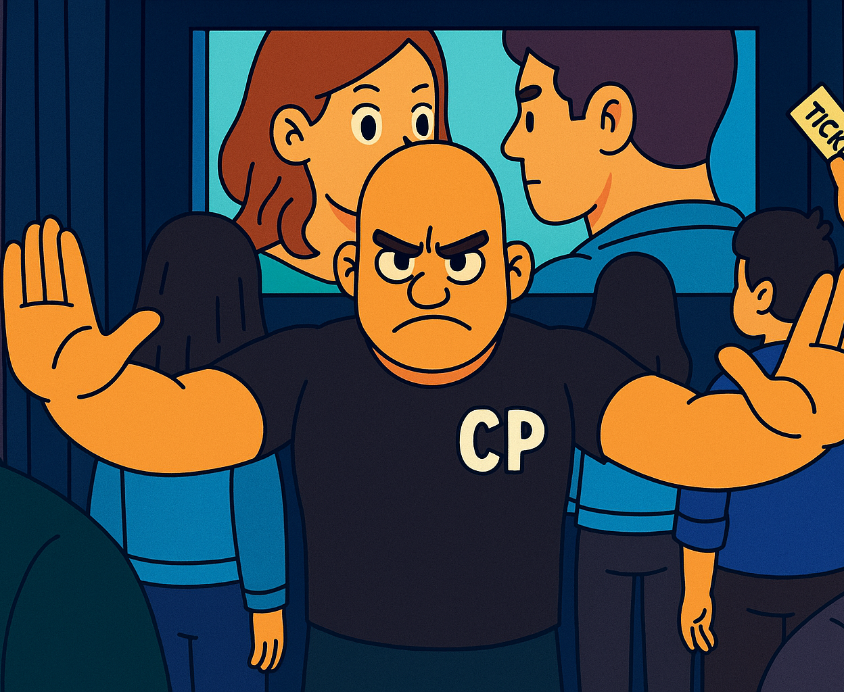
What and Why of Content Protection ?
Content creation comes with a price tag and it’s safe to say the creator would not want it stolen.
With the increase in the quality of content comes the need to protect it from people who want to consume it illegally.
Without content protection feature in place content was easily pirated and passed around. Some ways it did this was
Adding a capture device between a connector and the machine to copy over all the data.
Use a screen capturing app to pirate content.
So Content Protection is a way for content creators/providers to ensure everyone who is watching has actually paid for it and they don’t have a way of recording and redistributing the content illegally.

Slide 4

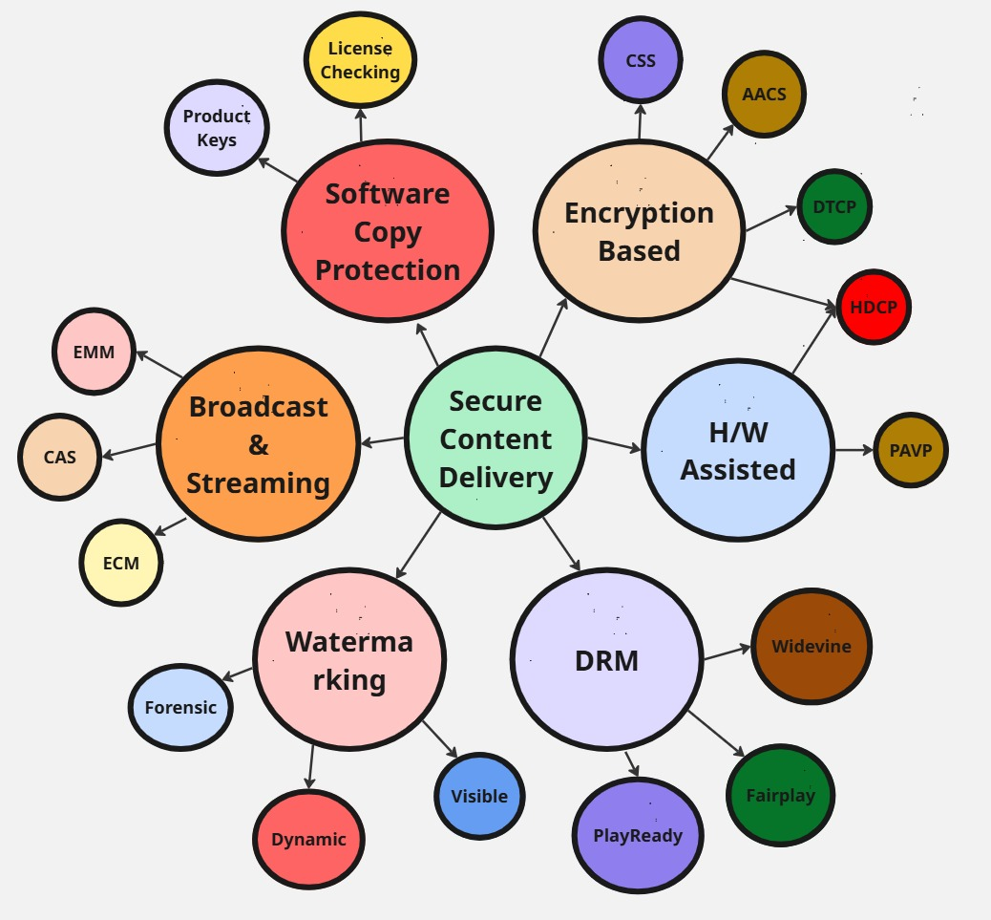
Types of Content Protection

Slide 5
HDCP

Slide 6
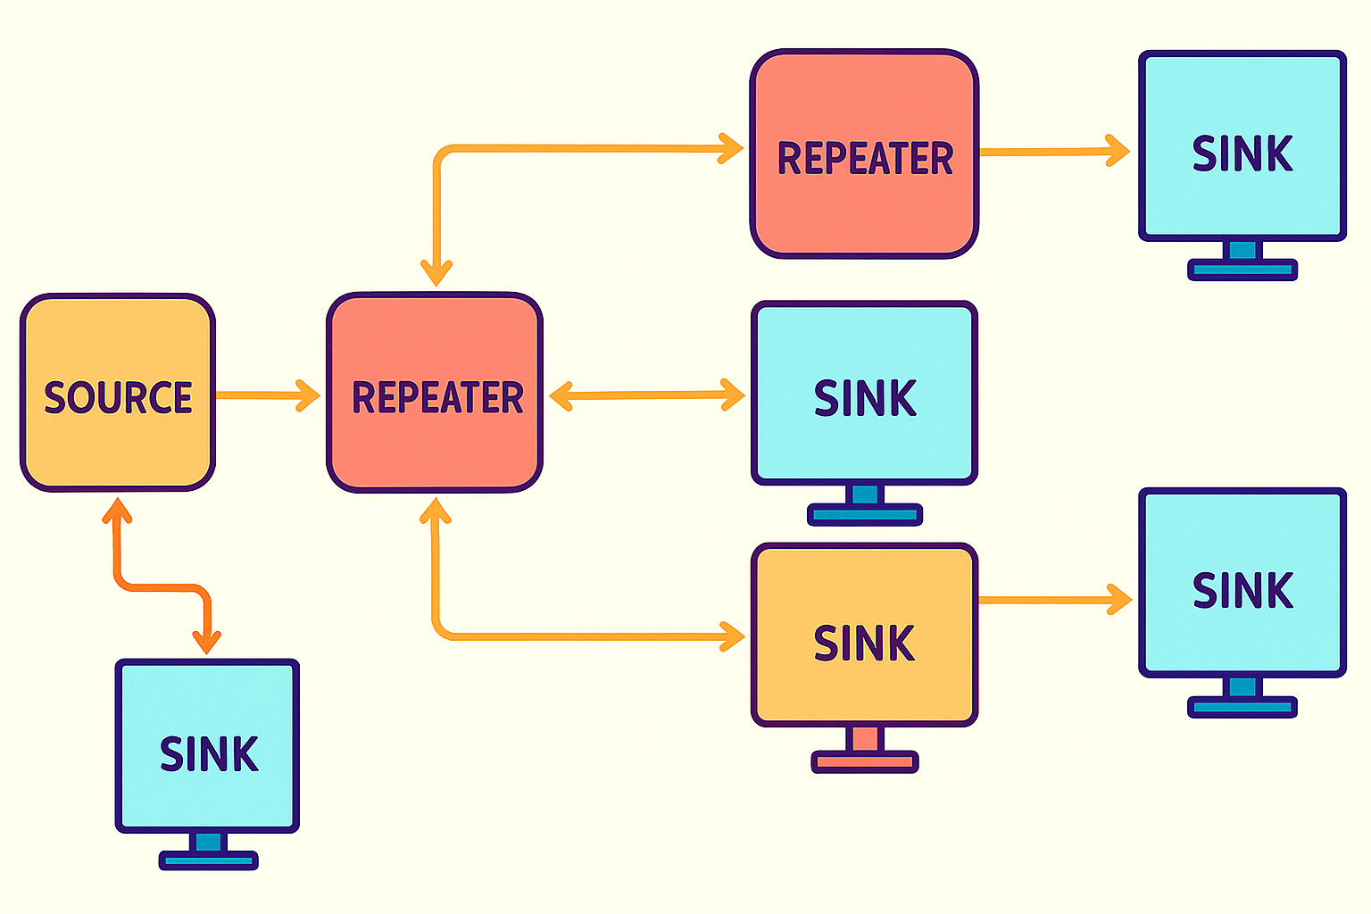
HDCP
High-bandwidth Digital Content Protection
Used to protect digital content as it moves from the source to sink.
Works with wired connectors like DP, HDMI, DVI connector.
HDCP Versions
HDCP 1.x
HDCP 2.x
HDCP Device
Source
Sink
Repeater
Adopted By
Sony ,Samsung, LG, Dell, Lenovo, HP ….
Intel, AMD, Nvidia, Apple
Apple Fairplay, Widevine
Mesa 3D, Wayland, VA-API, GStreamer
Netflix, Prime, Disney+

Slide 7


HDCP 1.x Vs HDCP 2.x
Why the need ?
HDCP 1.x got reverse engineered
HDCP 1.x was designed with HDMI and DVI but many new interfaces have come in.
Higher quality content came in
Used older and weaker algorithms like RC4.
Not usable for low power, latency and wireless use cases.
Why is HDCP 2.x better ?
HDCP 2.x takes into account the newer interfaces like HDMI2.0, DP, Type C.
Higher quality content came in.
Used stronger algorithms like RSA public key cryptography, AES etc.
Introduced Revocation List.
Supports both Type 0 & Type 1 content

Slide 8
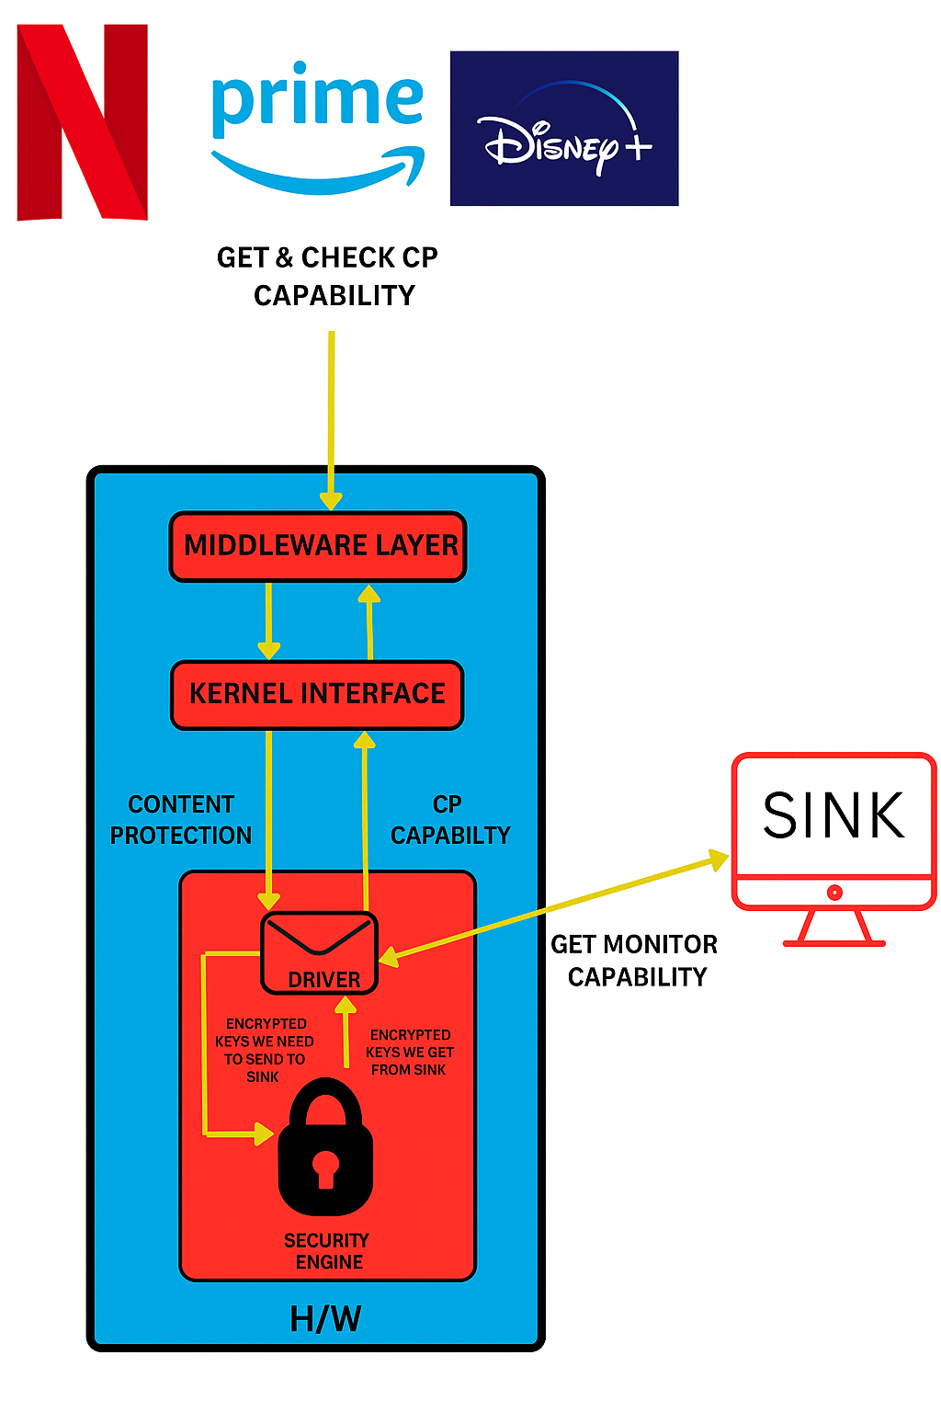
HDCP from userspace to driver
Two content protection properties through which userspace enables content protection.
CONTENT_PROTECTION
CONTENT_TYPE (Type 0, Type1)
Userspace can move the content protection property to every state other than ENABLED.
Driver can move the content protection property to every state other than UNDESIRED
Driver needs to signal the userspace whenever there has been a change in property

Slide 9
How does a driver handle HDCP ?
Driver is a messenger.
Source implements all its required algorithm within a security firmware in our case firmware
Sink has its own implementation within it and communicates the values we get from the algorithm via its in built registers e.g. DPCD registers when using DP connector
The drivers fetches value from the Source’s firmware sends it to the Sink, gets the value back keeps this going till HDCP authentication is completed.
There is also a periodic sanity check to see if HDCP is still enabled.
Along with this we have a list which is checked for blacklisted devices (Revocation List)

Slide 10
PAVP

Slide 11
PAVP
PAVP MAKES SURE NO SOFTWARE ON CLIENT IS ABLE TO SEE CLEAR CONTENT OR AUDIO OTHER THAN H/W
IT IS PAVP’s RESPONSIBLE TO CREATE SESSIONS WITHIN WHICH THIS ENCRYPTED CONTENT NEEDS TO FLOW
For encryption/decryption to be enabled a session has to be enabled.
This is done on a per plane, per surface basis when.

Slide 12
HDCP & PAVP
PAVP & HDCP work together to make sure H/w encryption takes place for external dispay.
PAVP takes care of creating the session while HDCP takes care of creating a authenticated and trusted link between the source and sink.
HDCP does not come into picture for embedded displays since the medium is already trusted and PAVP in itself is sufficient.

Slide 13
Challenges & Downsides of CP
Older platforms not supporting the latest content protection versions may cause black screen or lower quality video due to authentication failures.
Increases cost in the following ways:
Cost of firmware, chips, certification etc.
Cost of implementation.
Cost of computation due to encryption and decryption cycles.
If broken it is hard to revoke a standard without affecting legitimate users
Often CP algorithms are not allowed to be implemented via open-source drivers forcing use of firmware and other workarounds.

Slide 14
References
https://lkml.iu.edu/hypermail/linux/kernel/1801.1/00923.html
http://digital-cp.com/hdcp-specifications
https://link.springer.com/chapter/10.1007/978-1-4302-6572-6_8

Slide 15
Thank you

